Slide 1

Native and Edible Landscapes
Restoring Wildlife Habitat and Producing Healthy Food

Slide 2
The Case for Regenerative Landscapes
Problems with Conventional Landscaping
Labor intensive (constant mowing, repair)
Waste of resources (water, fertilizer, pesticide)
Little environmental benefit (no habitat, or plant diversity)
Environmental problems (polluted runoff)
Little human benefit (food, cost, aesthetics)

Slide 3
The Case for Regenerative Landscapes
Benefits of Regenerative Landscaping
Labor get less and less as landscape becomes regenerative
Resources are recycled and landscape becomes healthier
Environmental benefit (wildlife habitat, pollinators, plant diversity, water conservation and infiltration)
Great return on investment (healthy food, aesthetics, savings on food/energy/water)

Slide 4
The Key is Education
Becoming familiar with your site conditions
Understanding your native soil
Set up a strategy and a plan
Knowledge of plants (natives, edibles, water demands, maturity size, habitat benefits…)

Slide 5
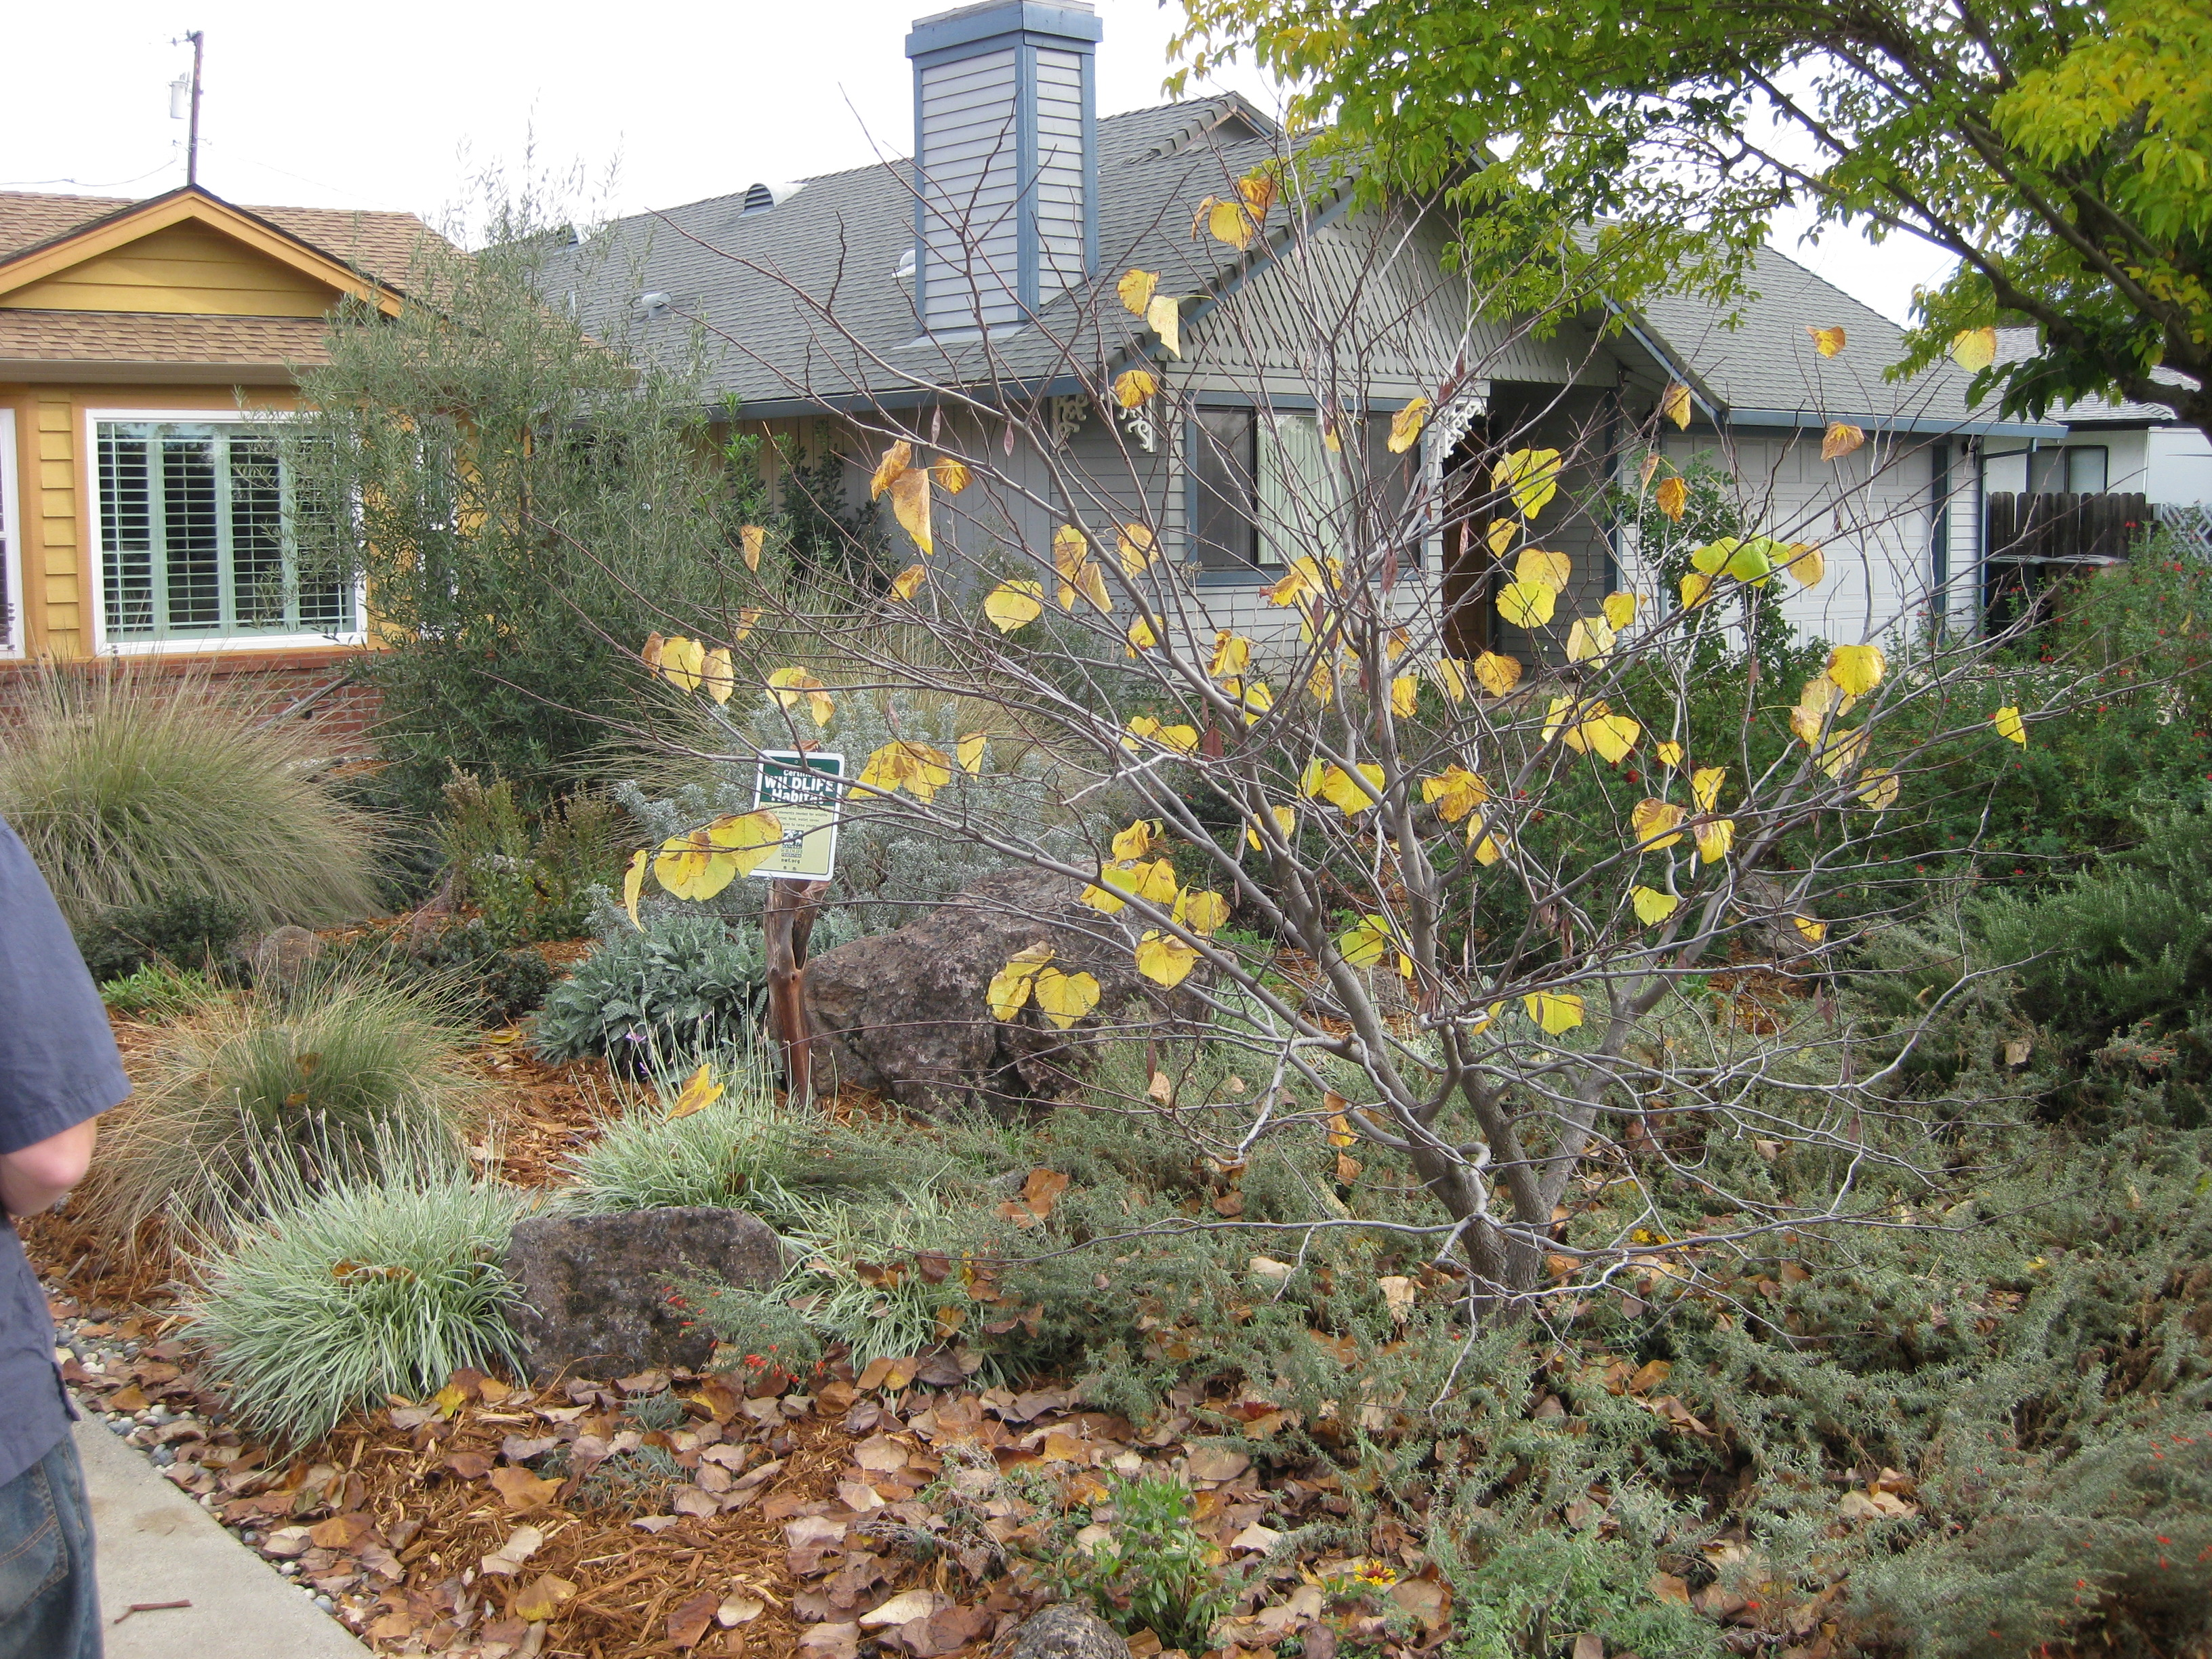
Native Landscape

Slide 6
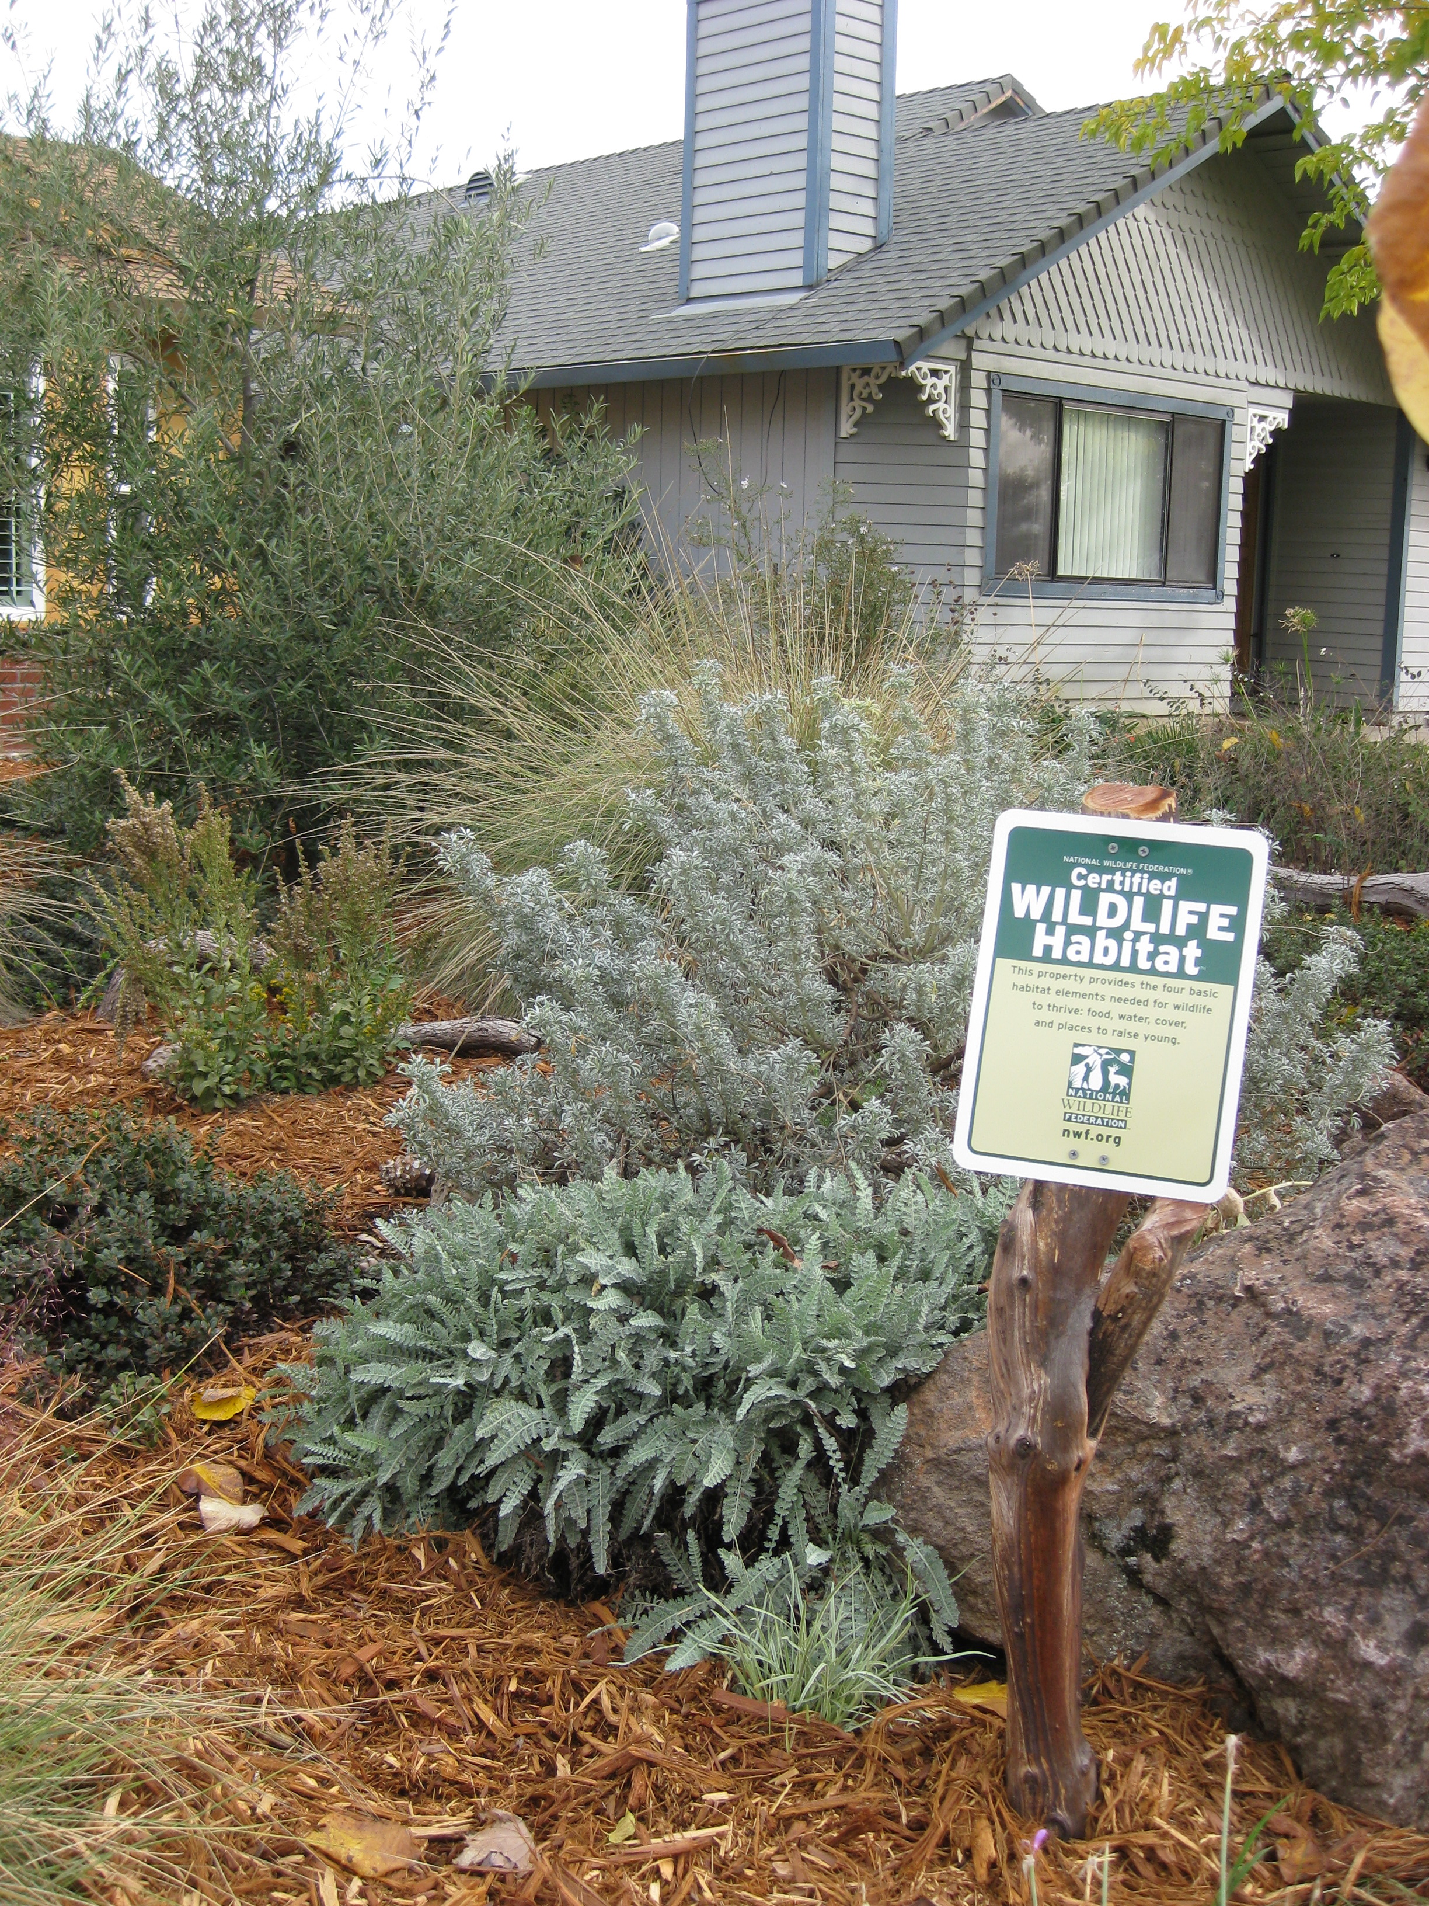
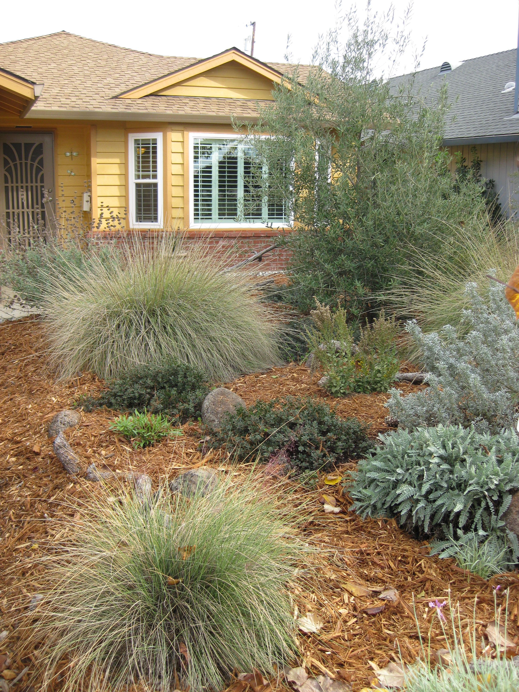
Native Landscape

Slide 7
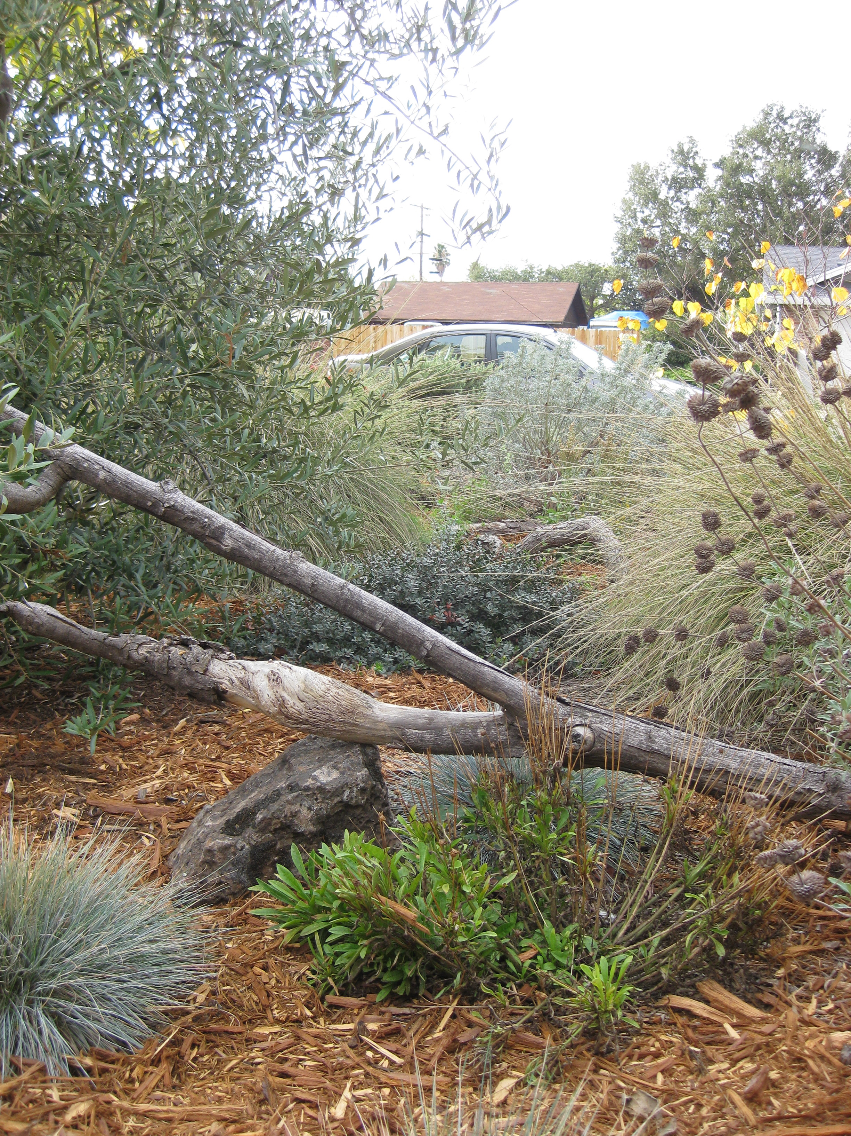
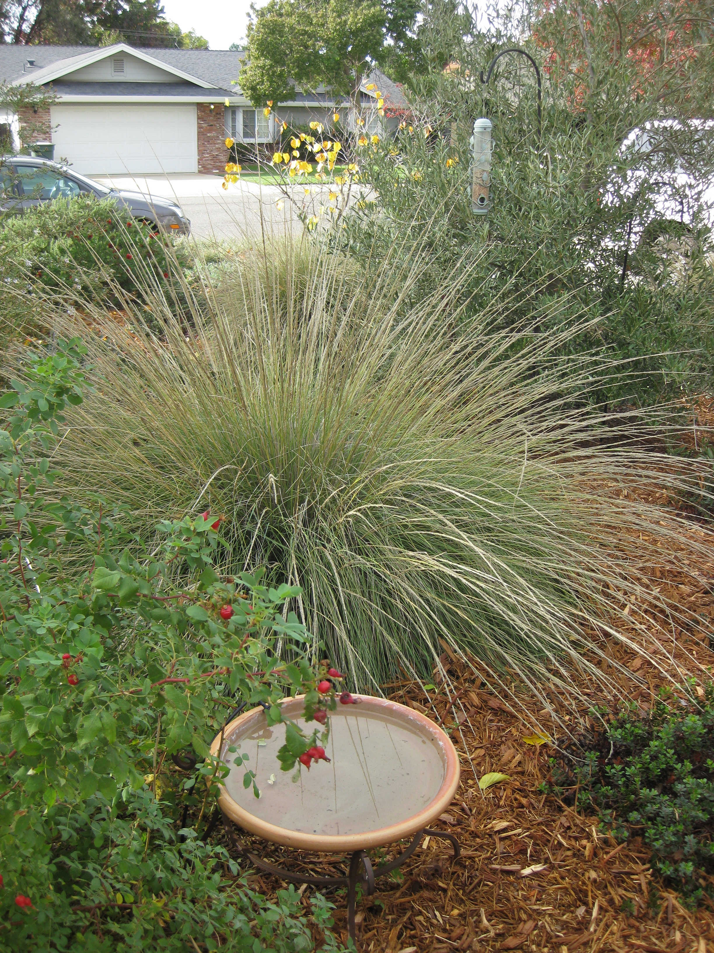
Native Landscape

Slide 8
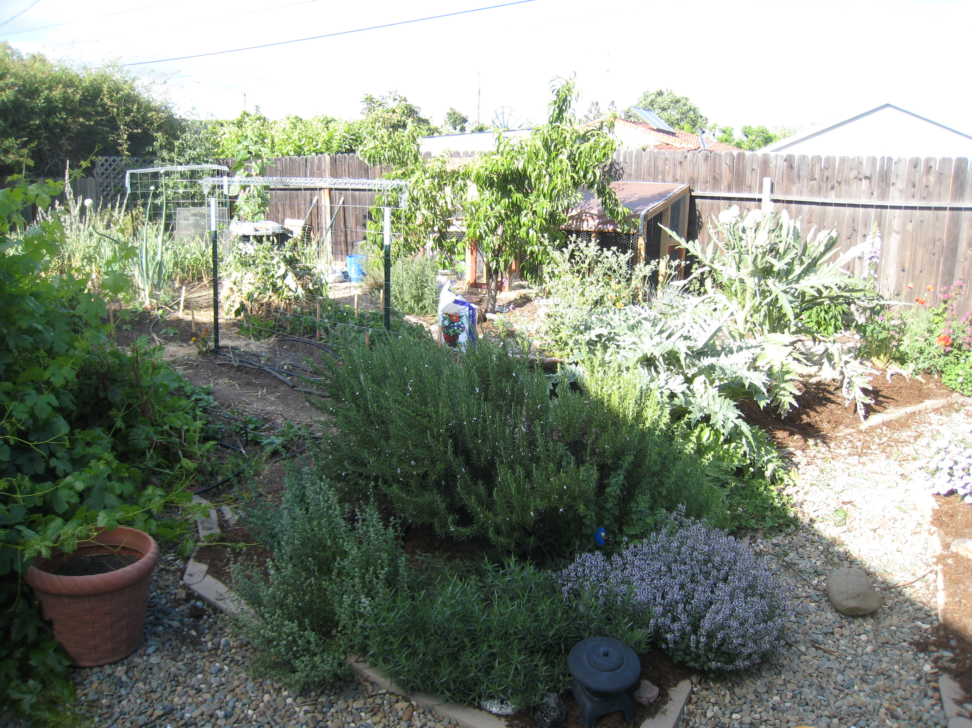
Edible Landscape

Slide 9
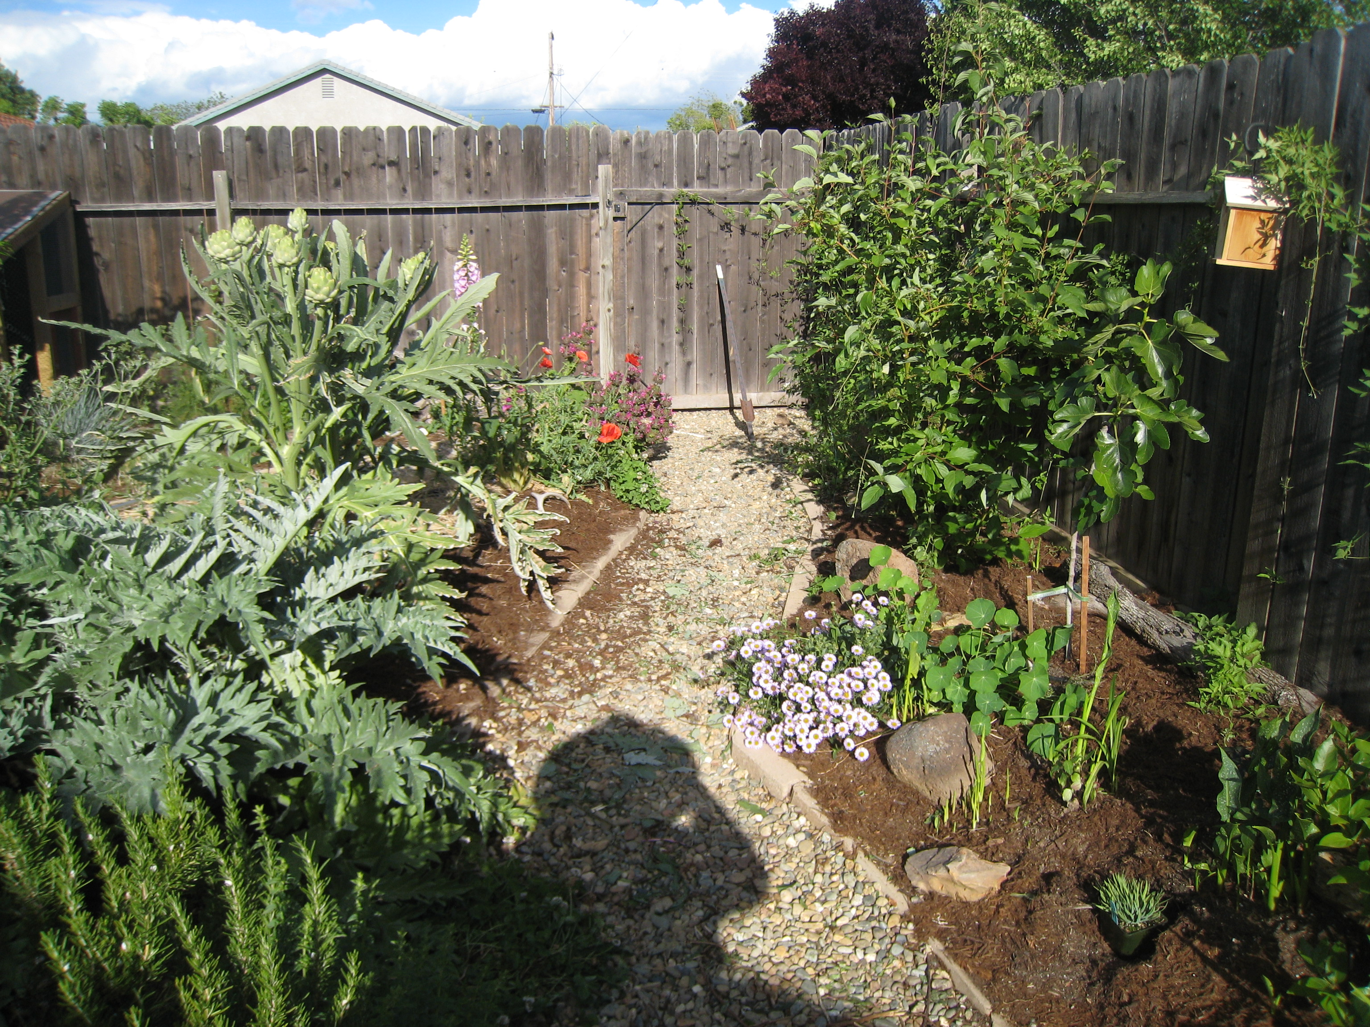
Edible Landscape

Slide 10
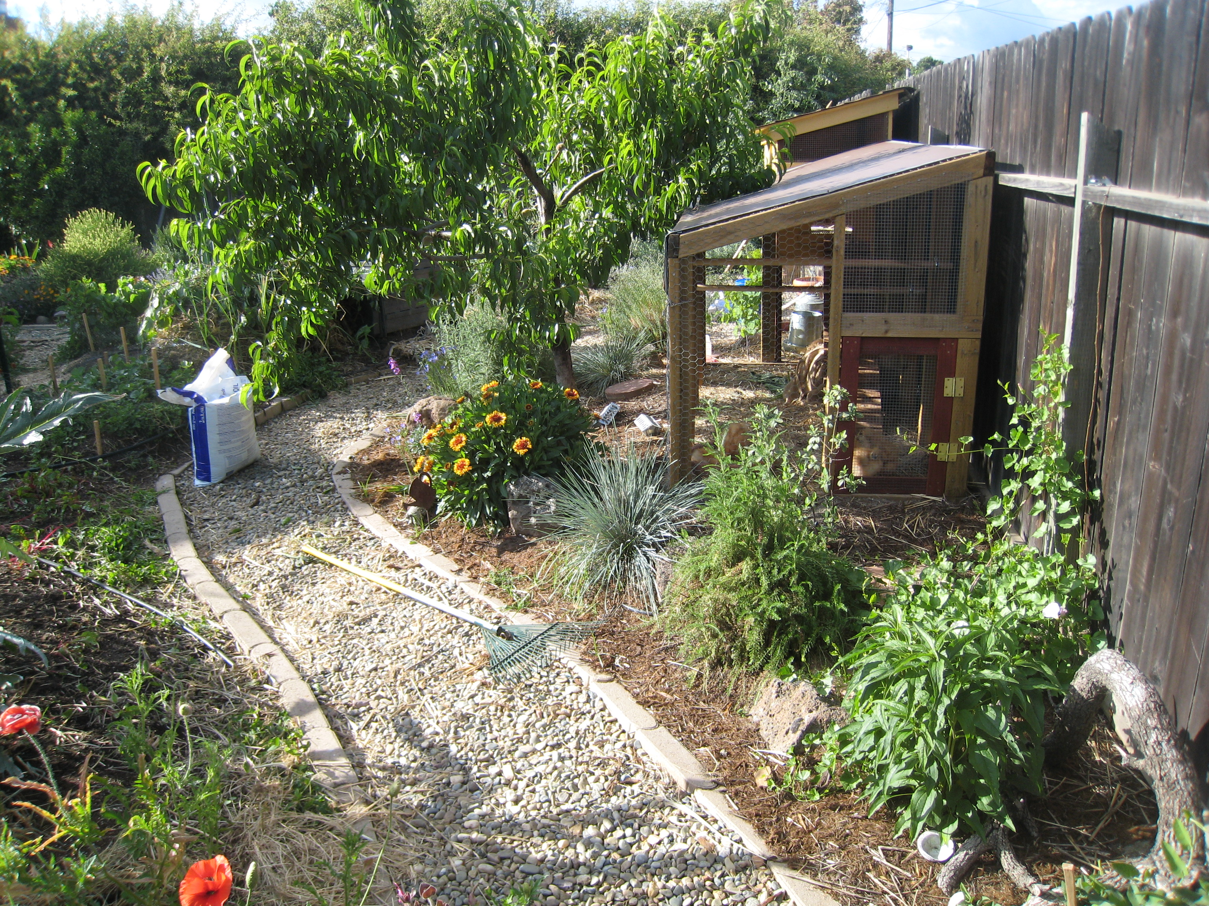
Edible Landscape

Slide 11
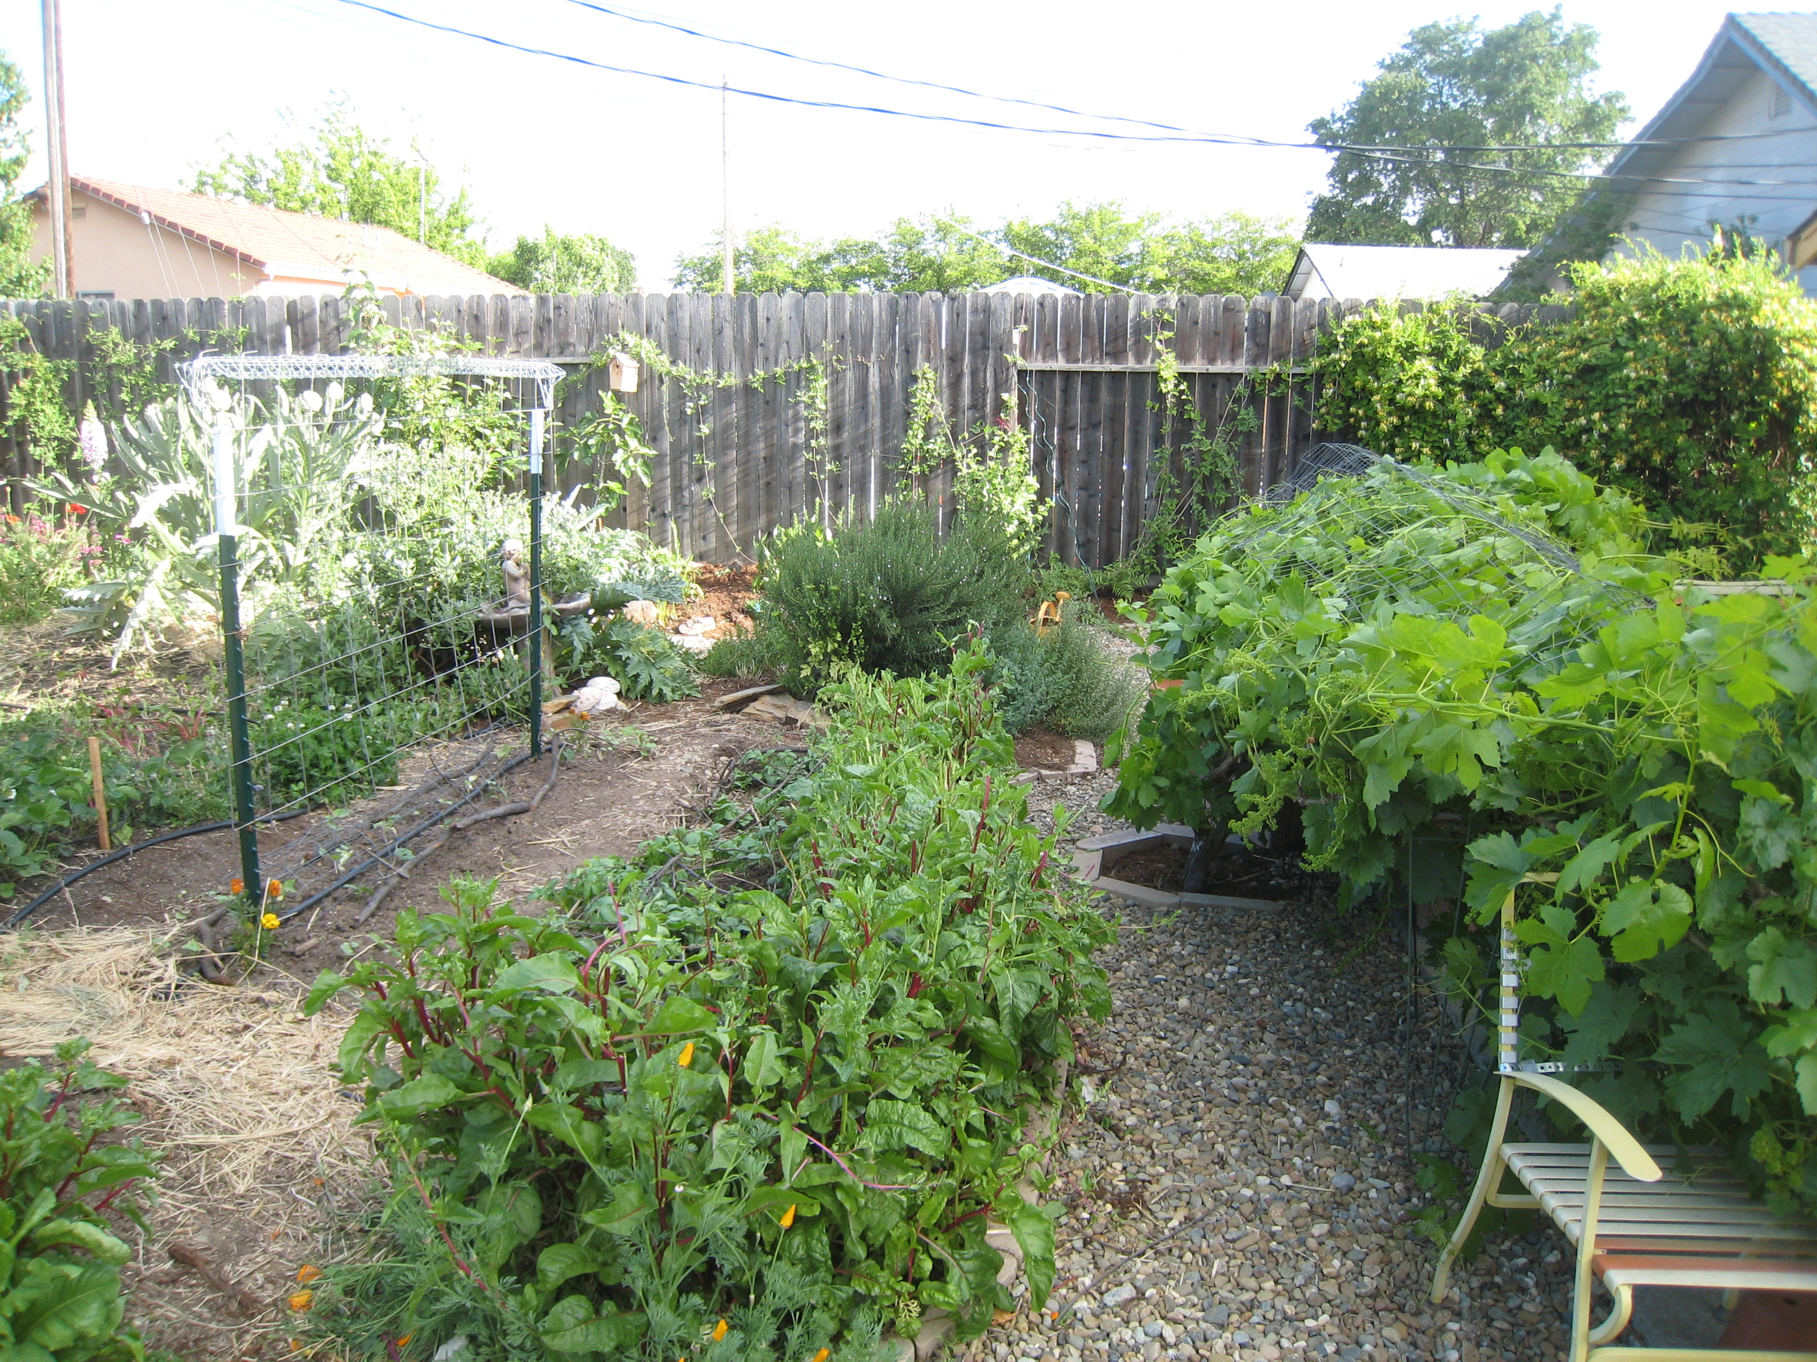
Edible Landscape

Slide 12
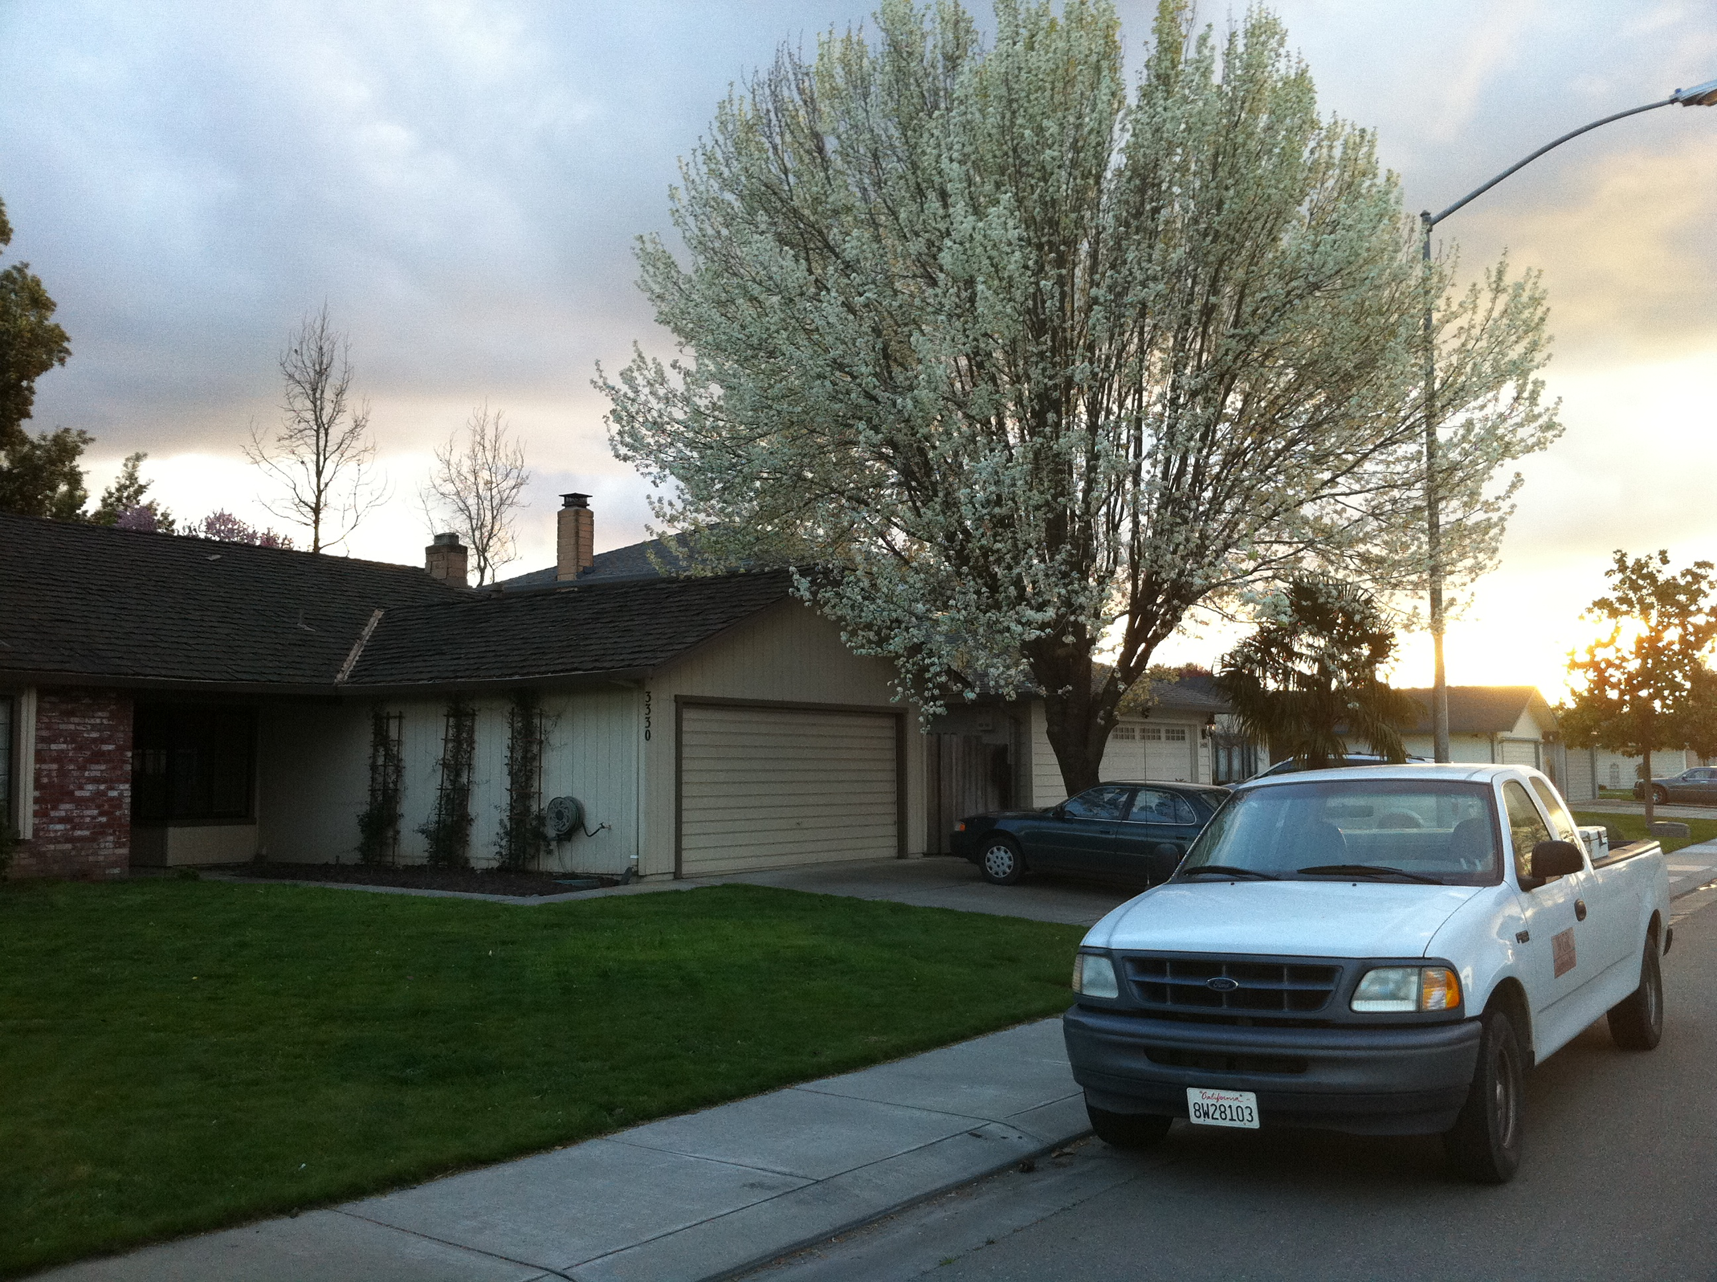
Sheet Mulching

Slide 13
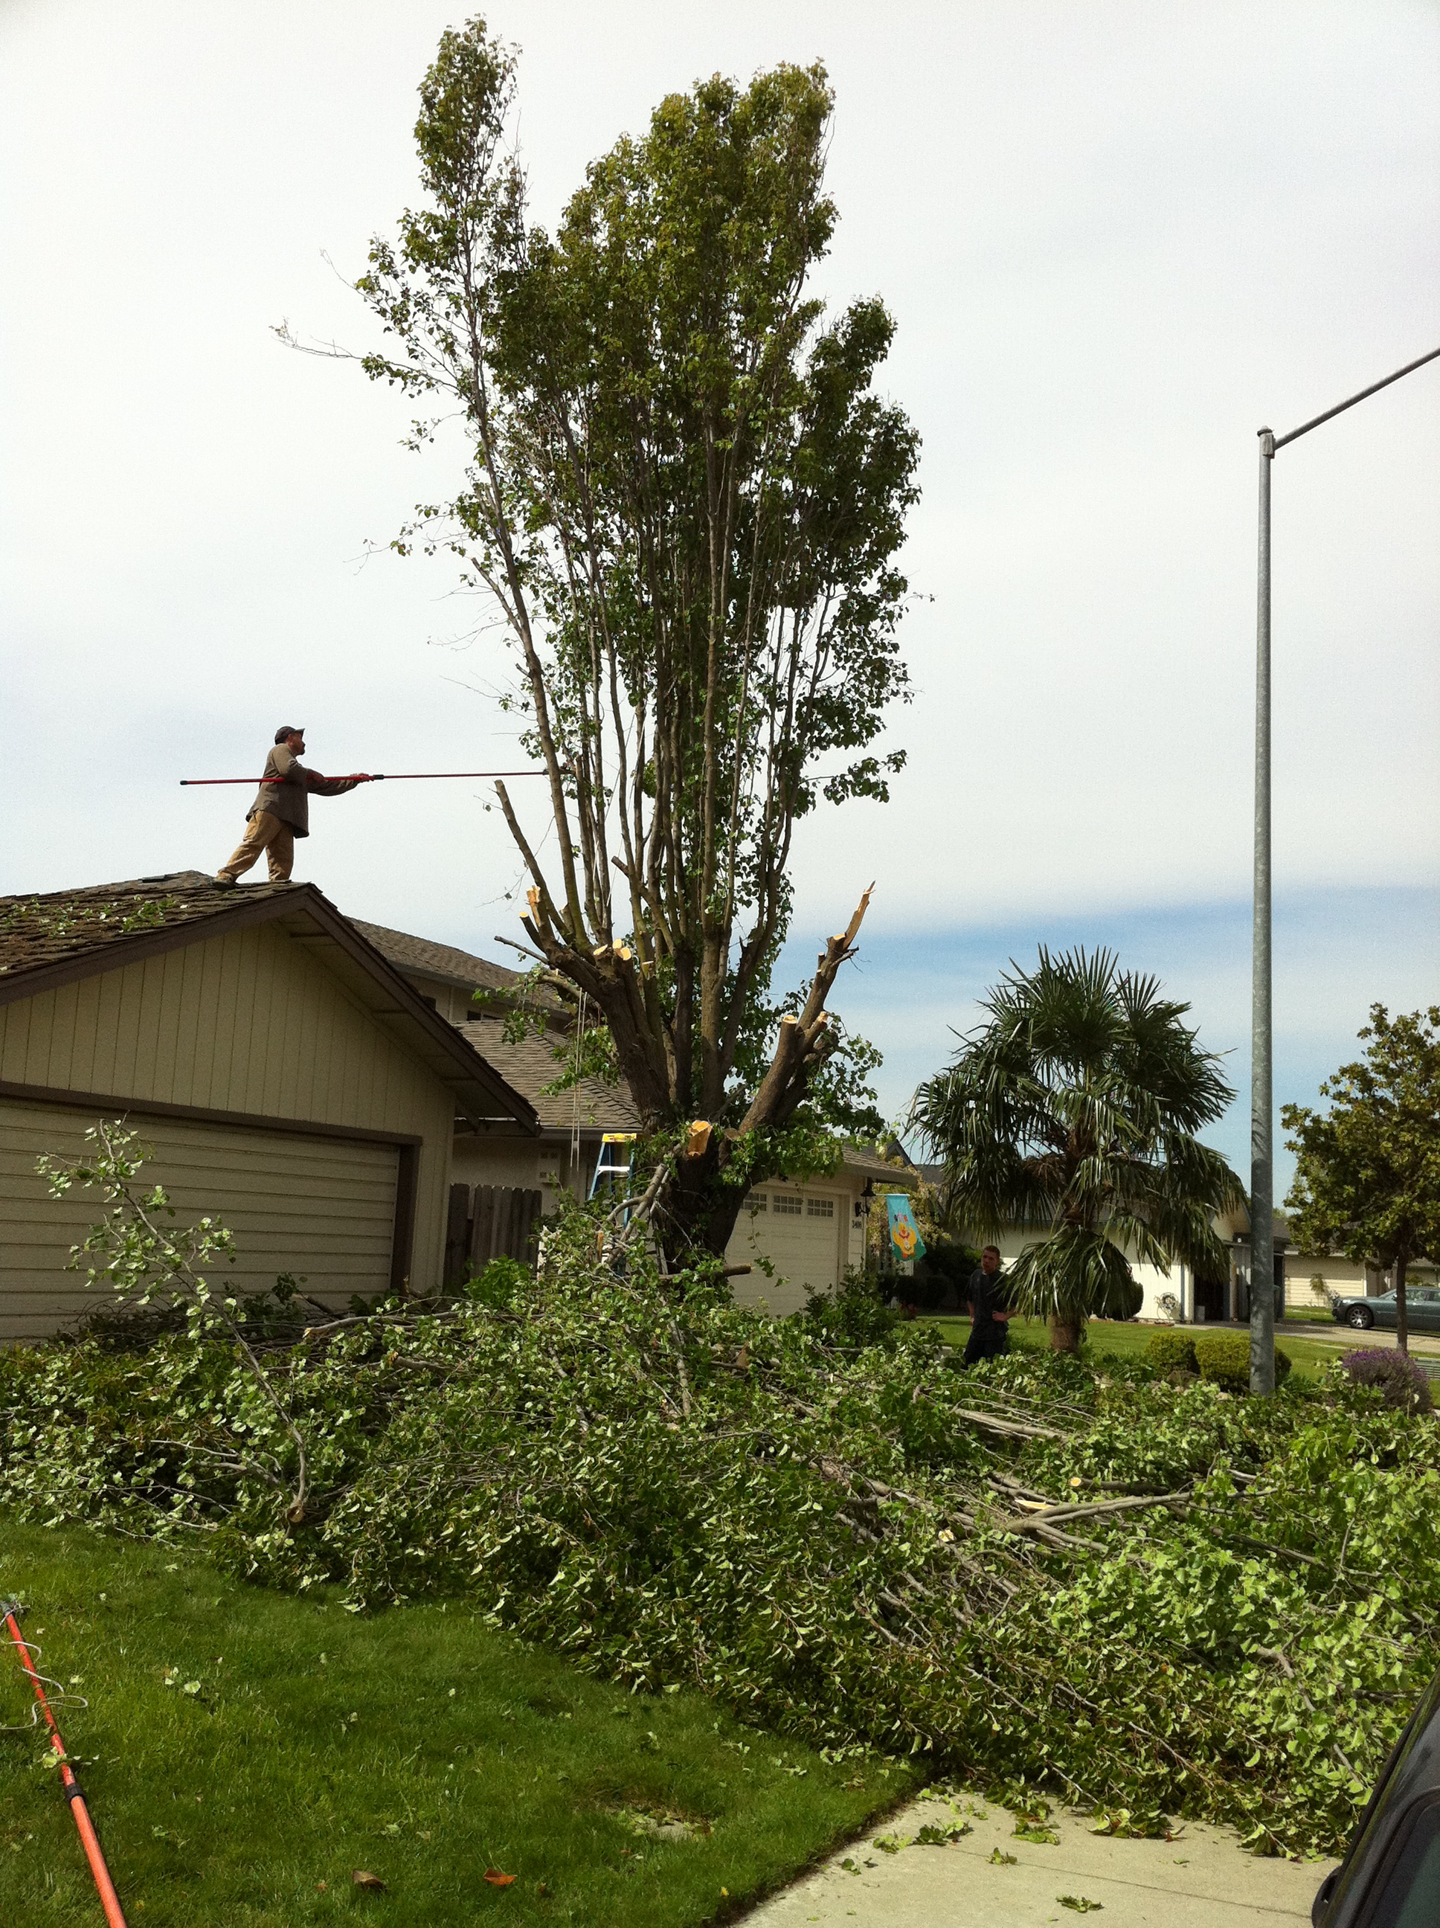
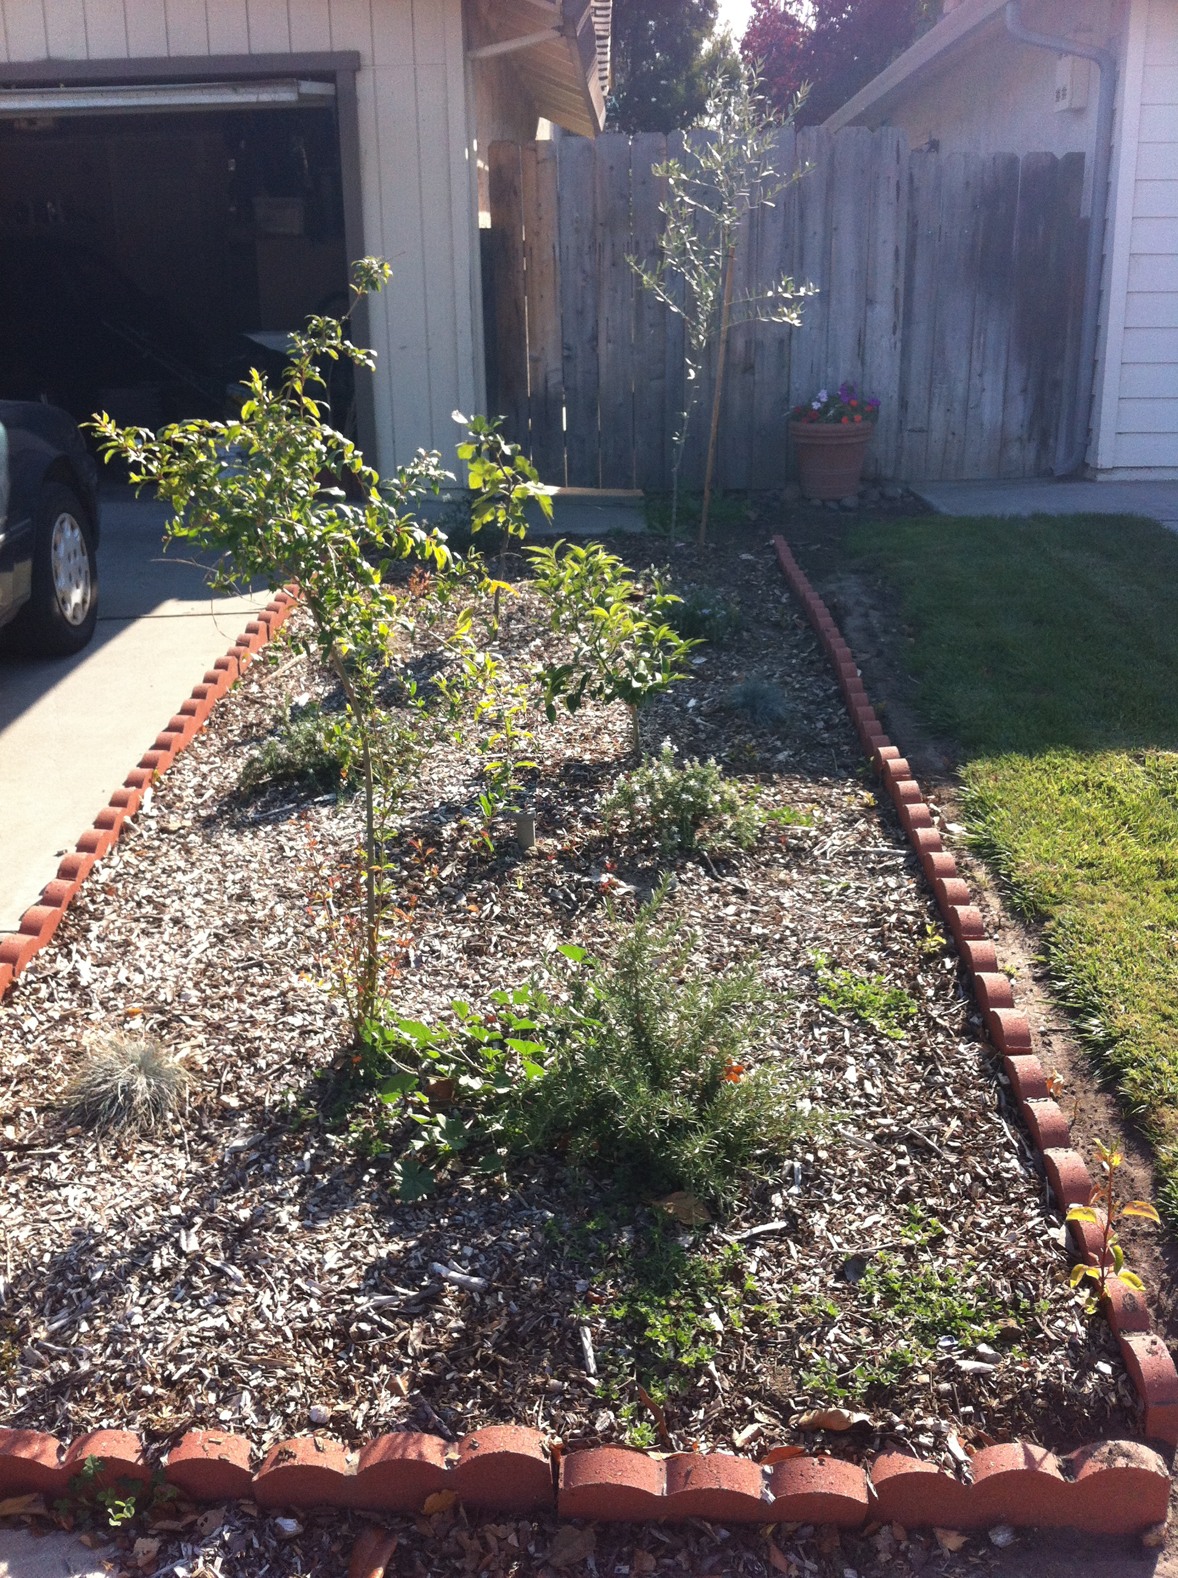
Sheet Mulching

Slide 14
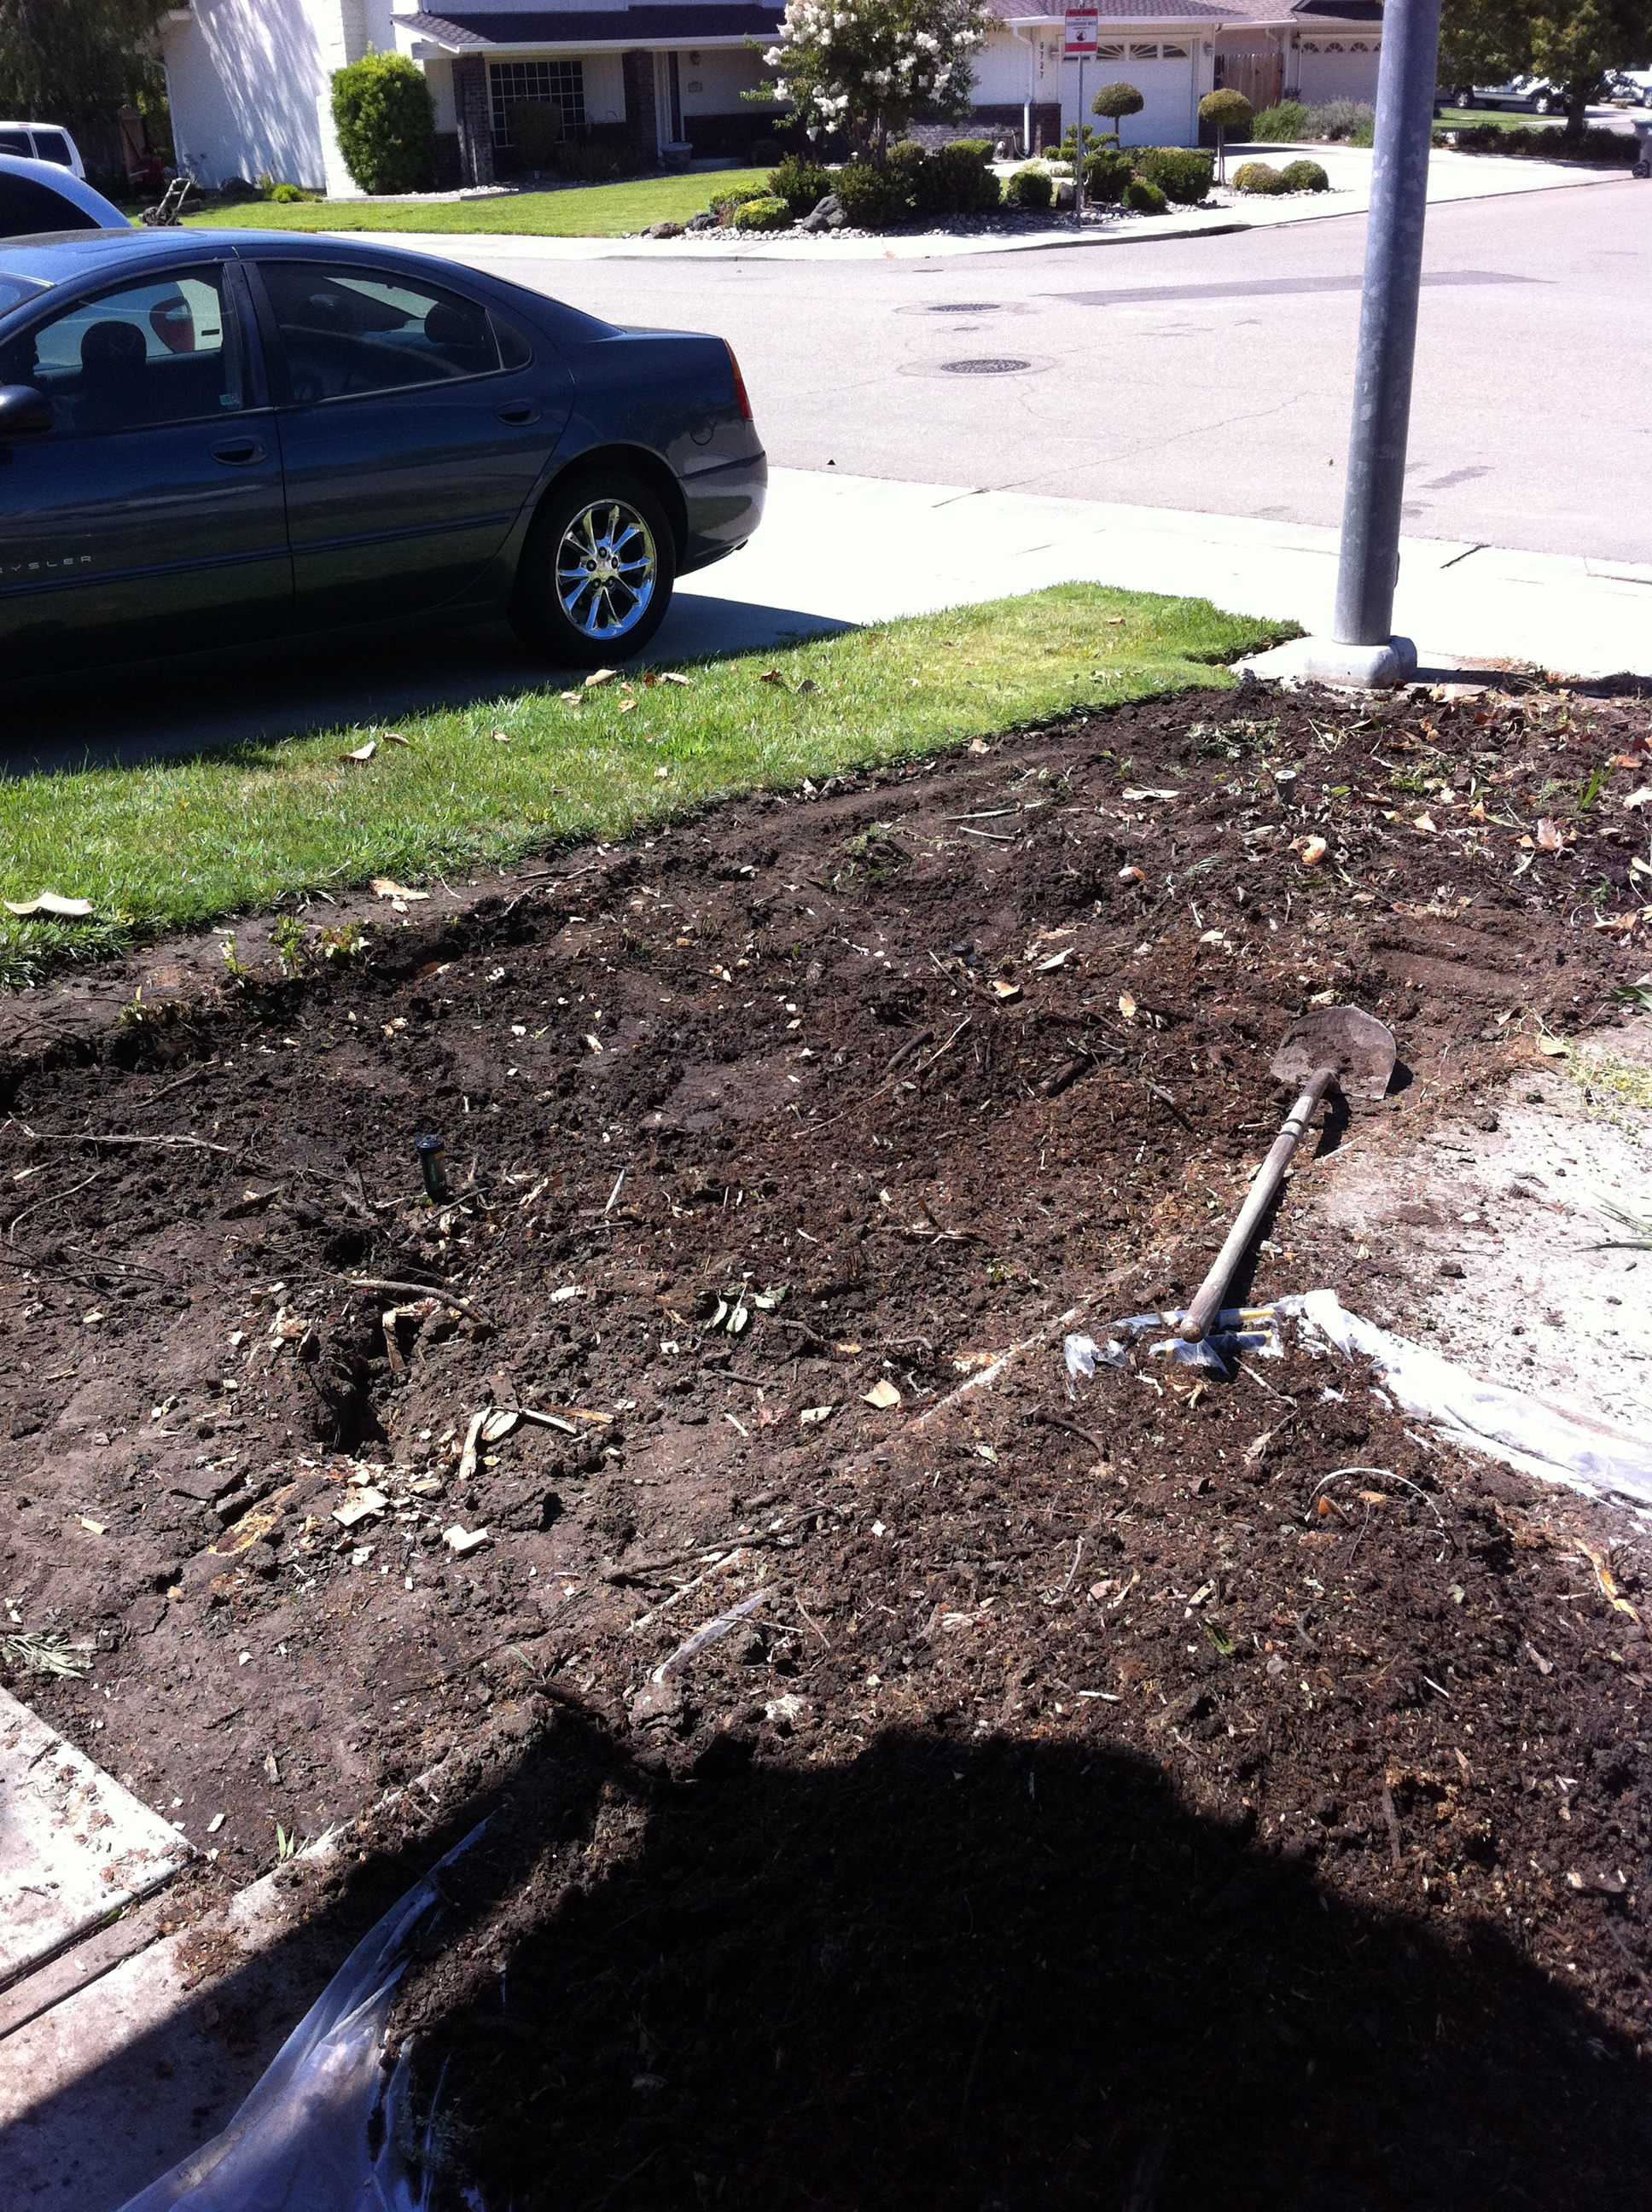
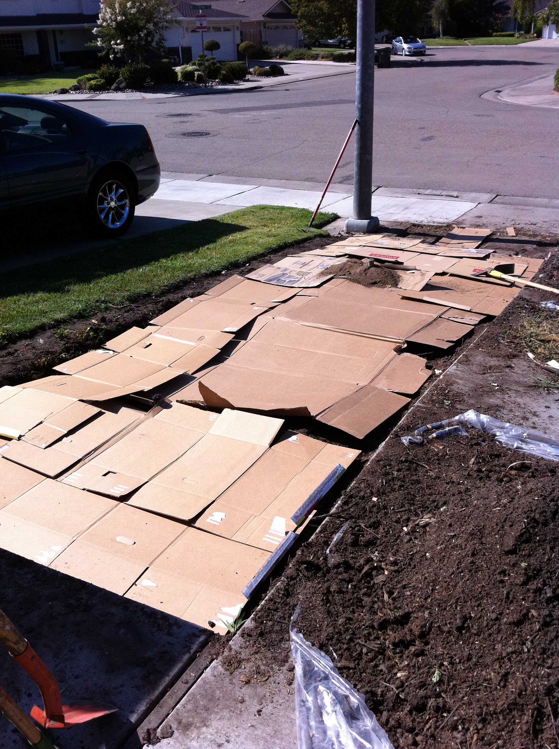
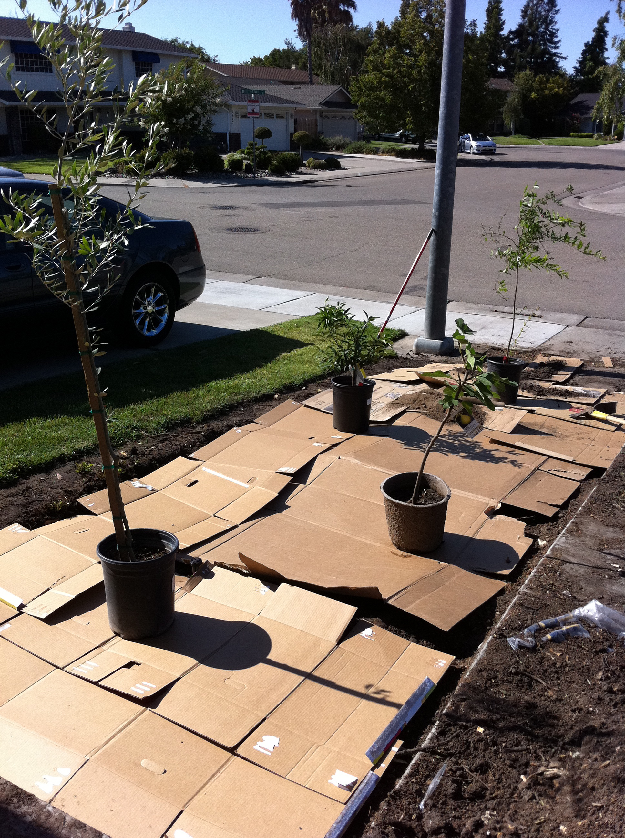
Sheet Mulching

Slide 15
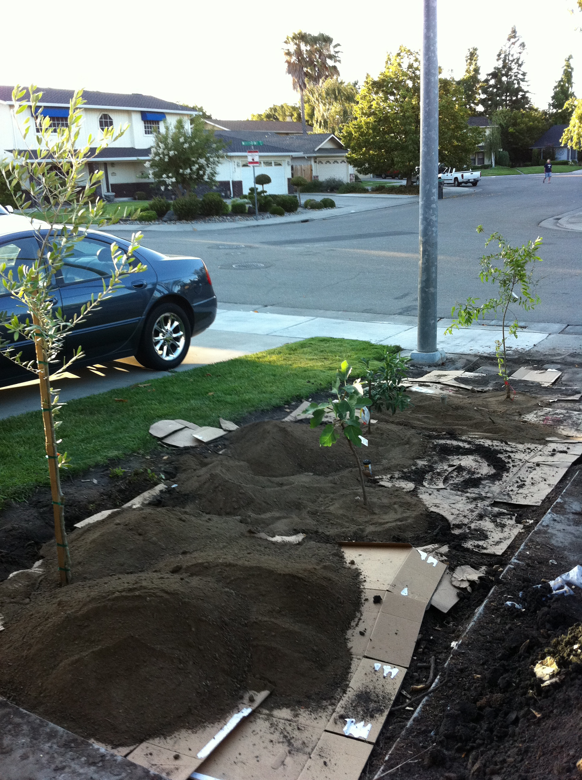
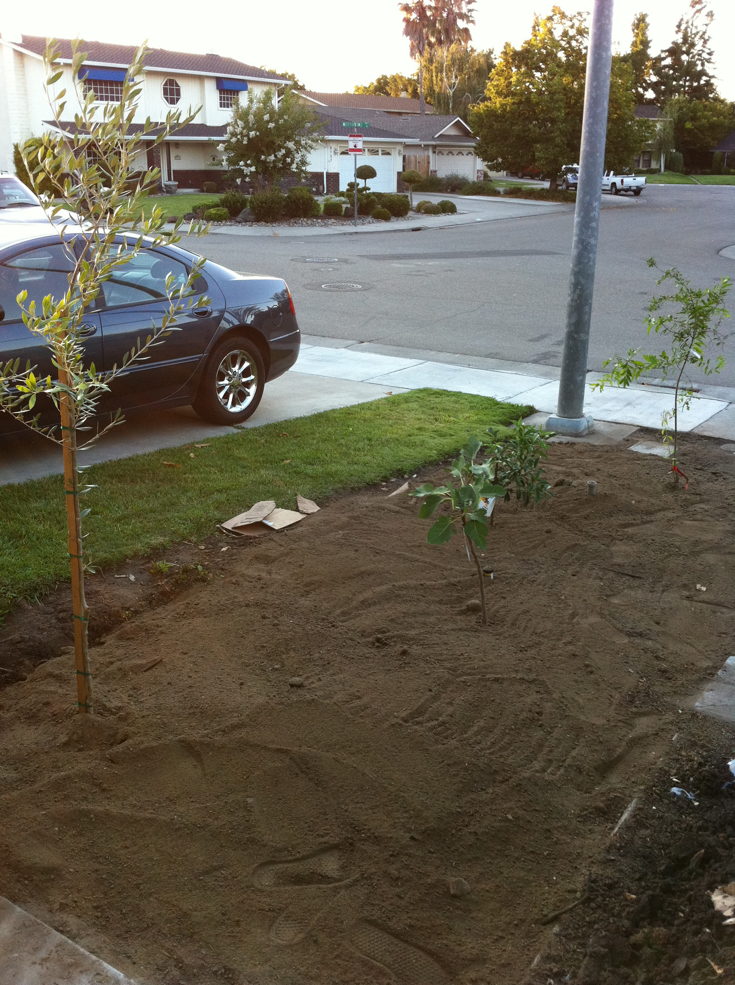
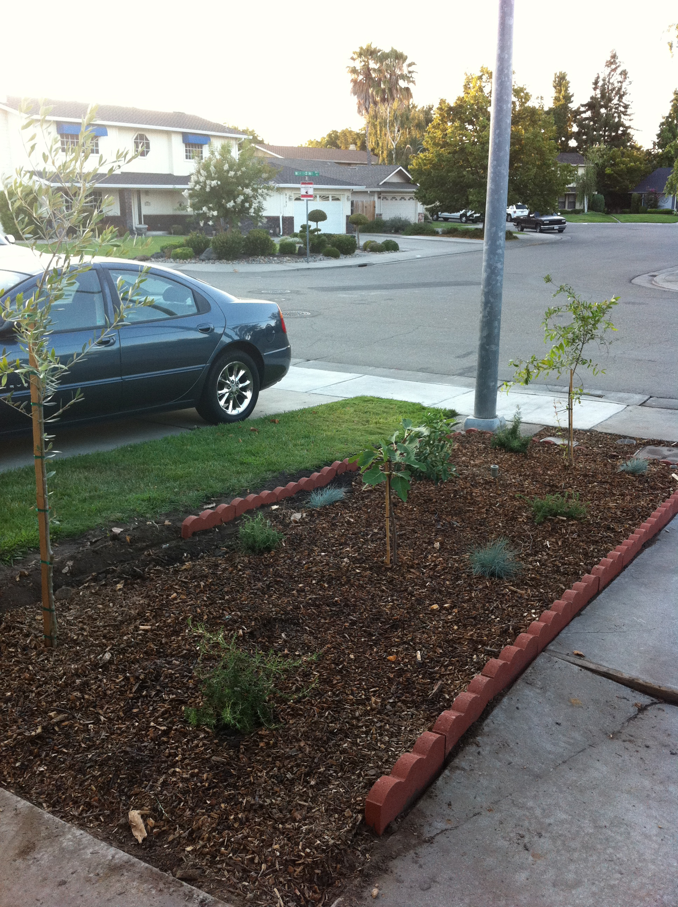
Sheet Mulching

Slide 16
Sheet Mulching

Slide 17
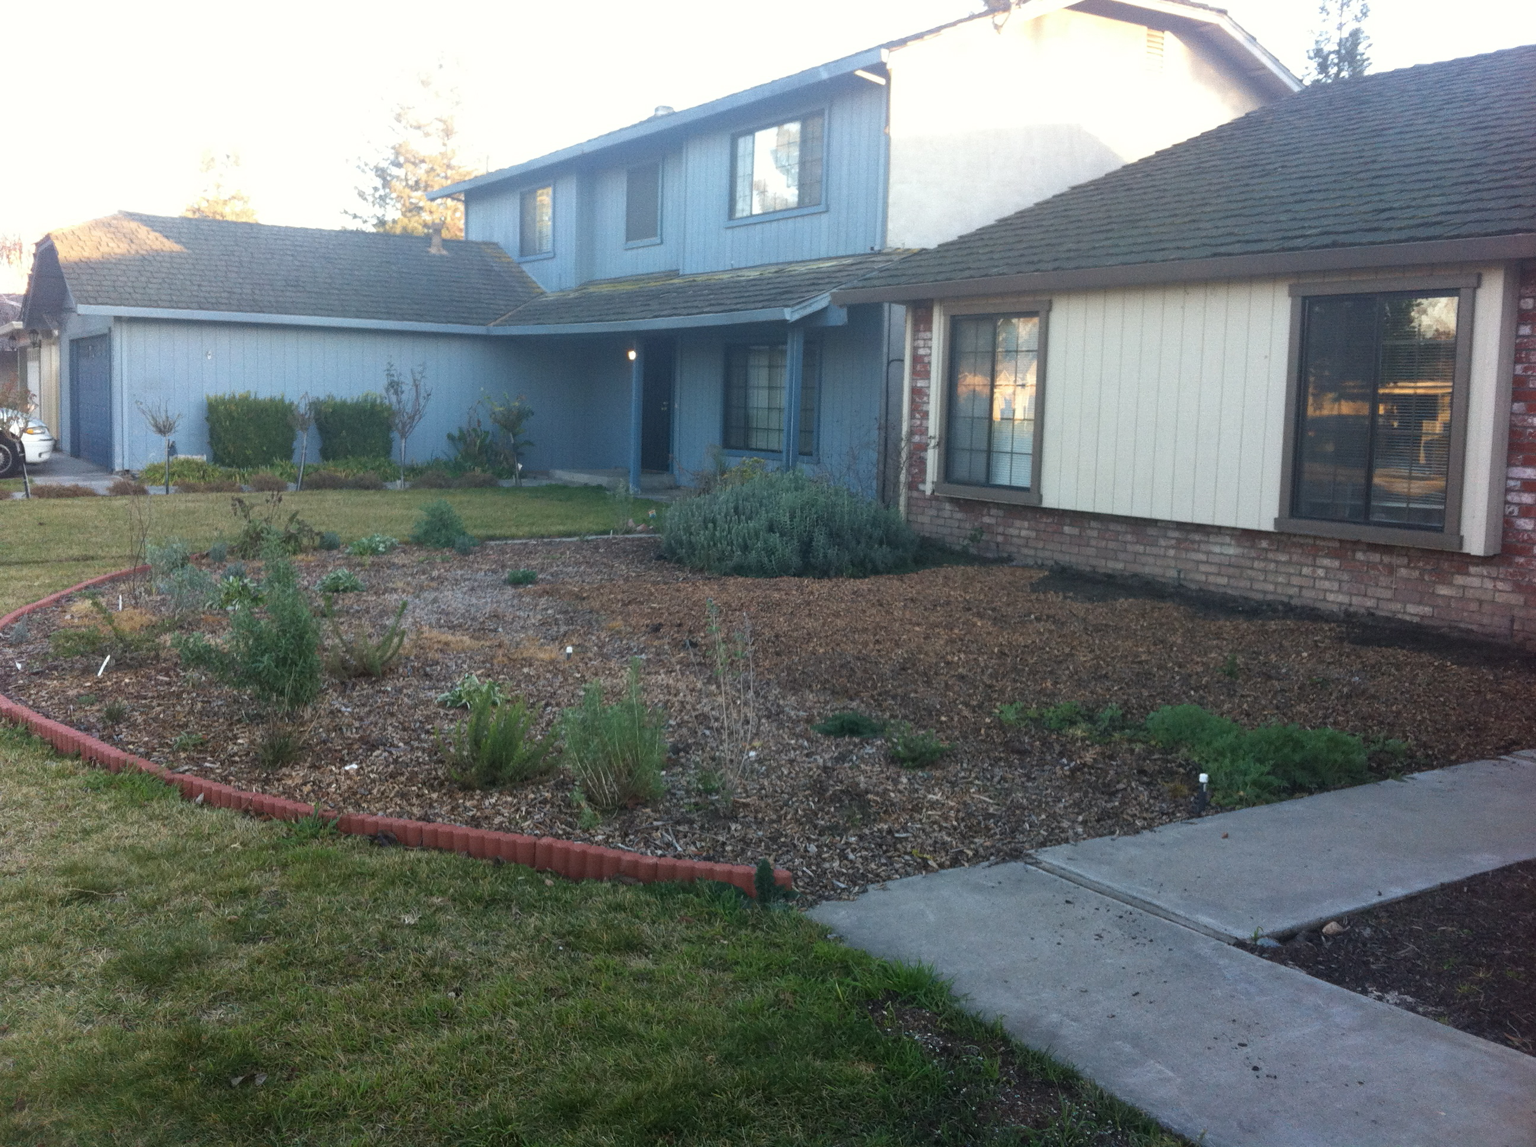
Native Front Yard Hedgerow

Slide 18
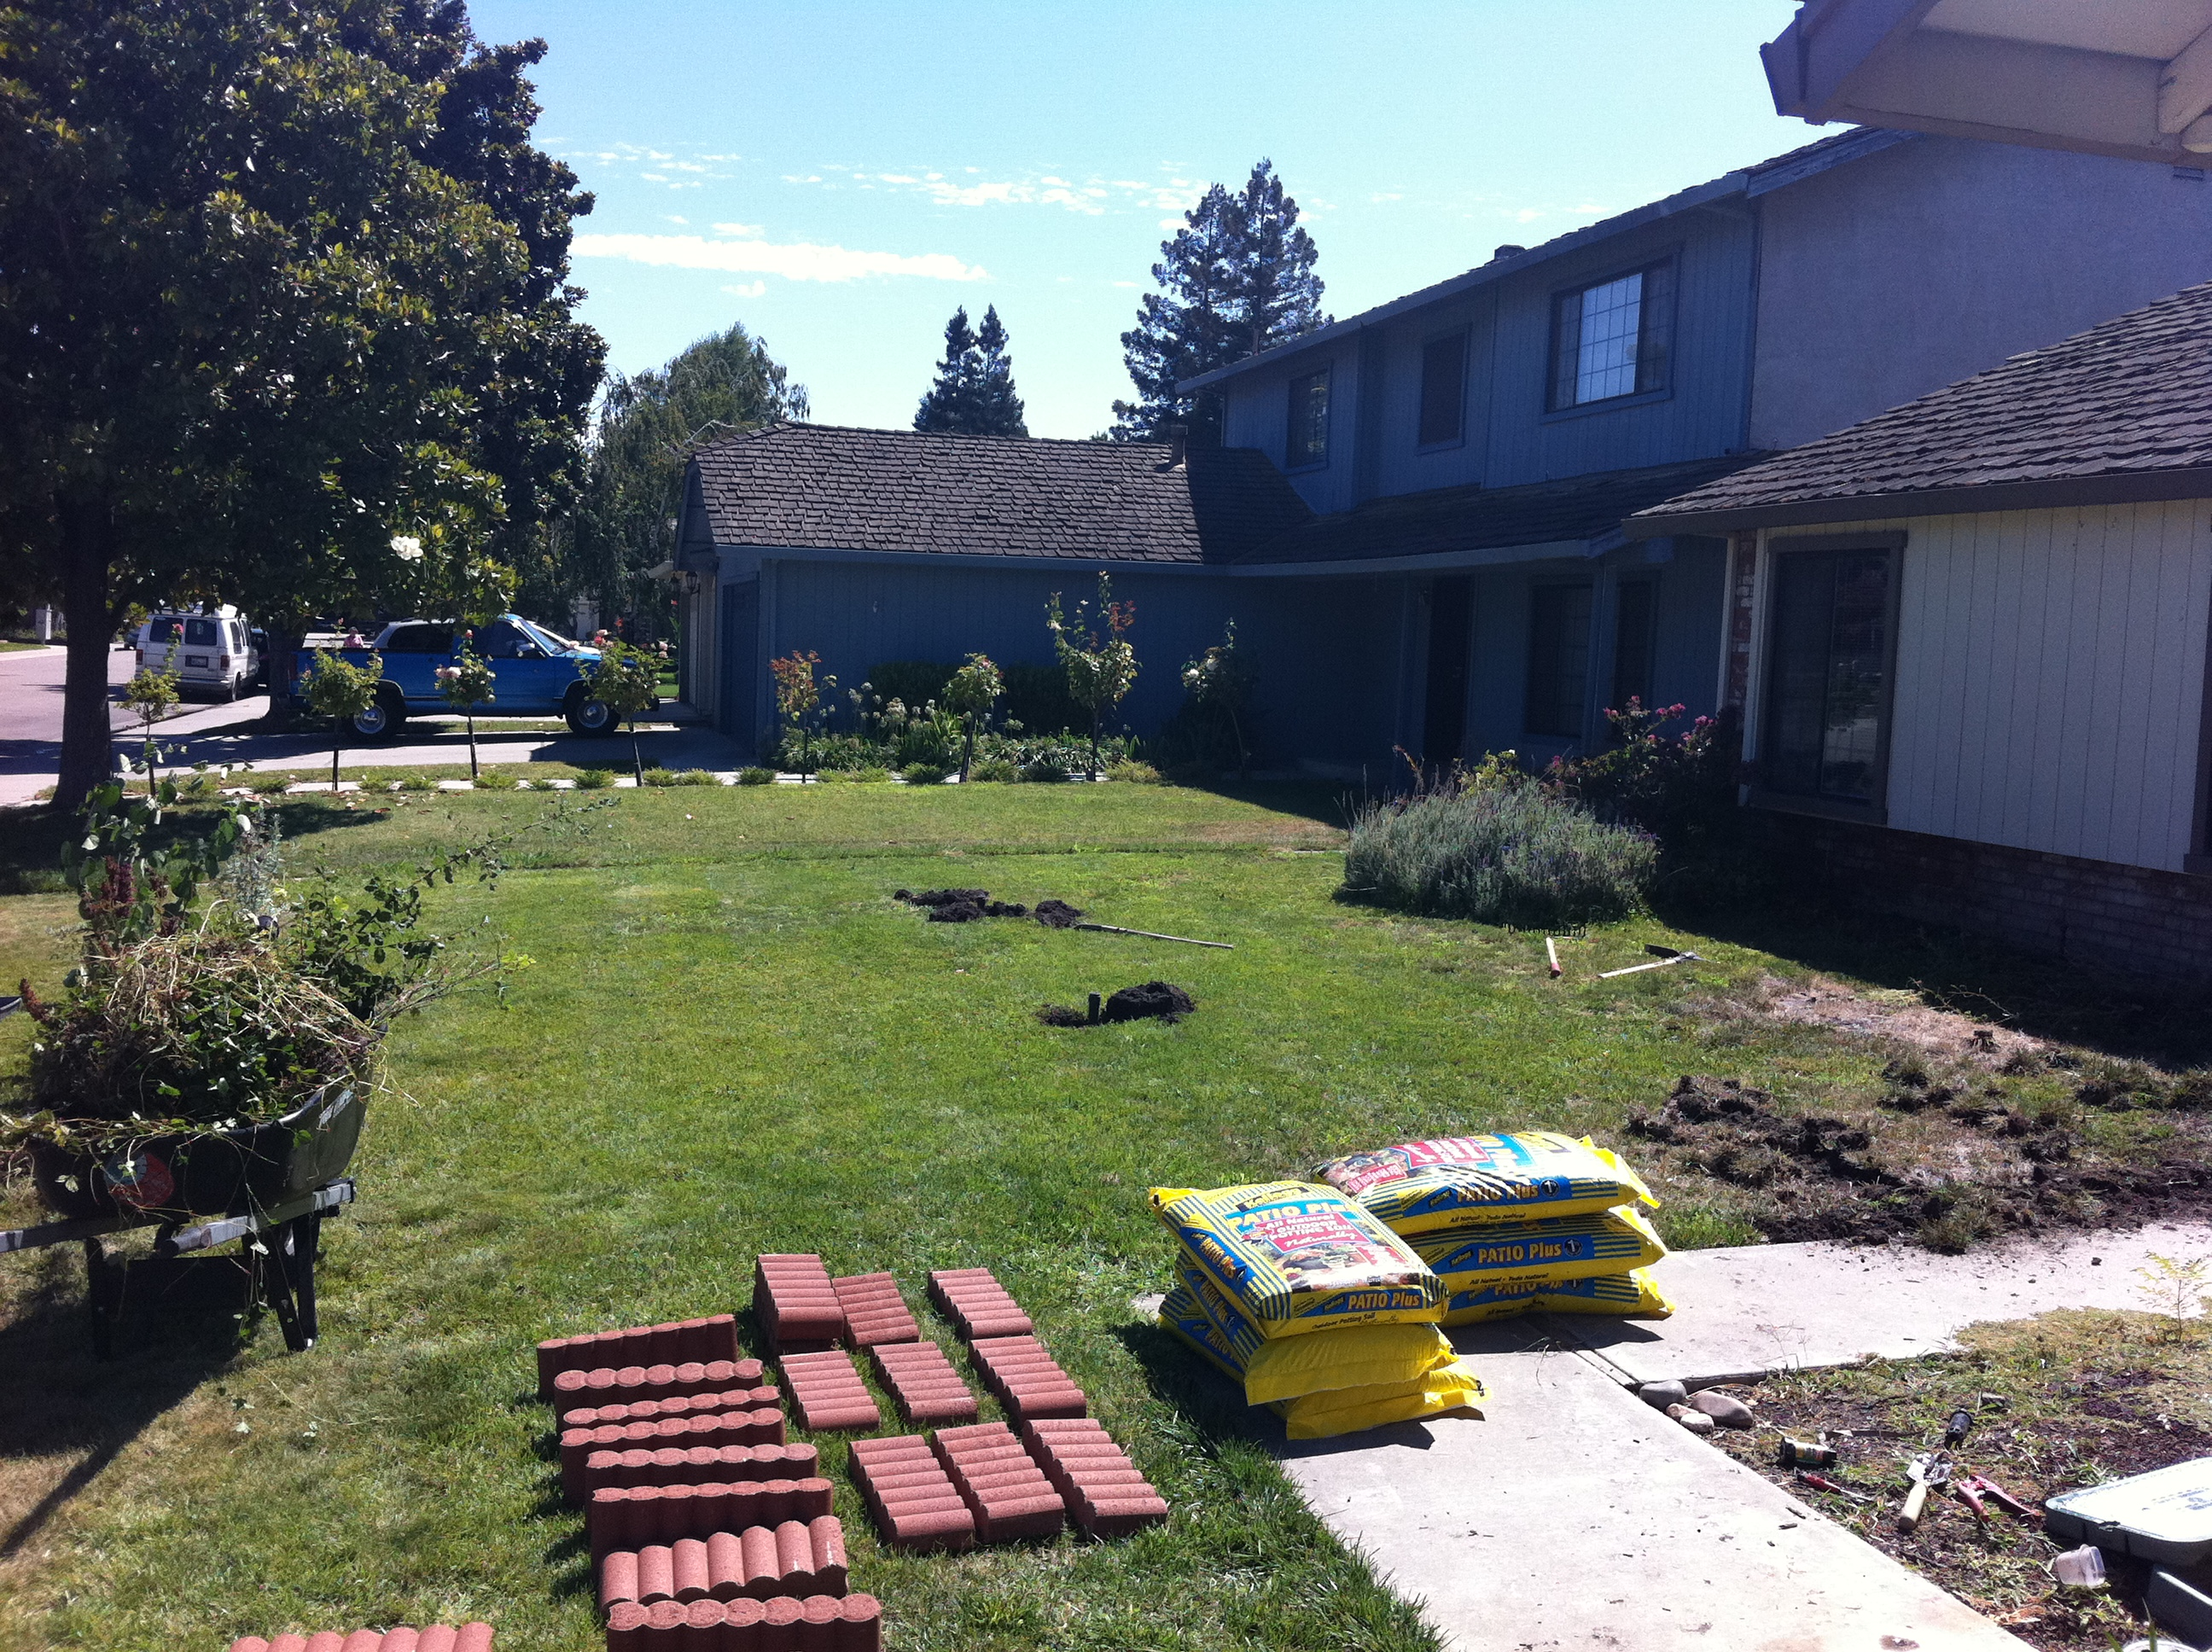
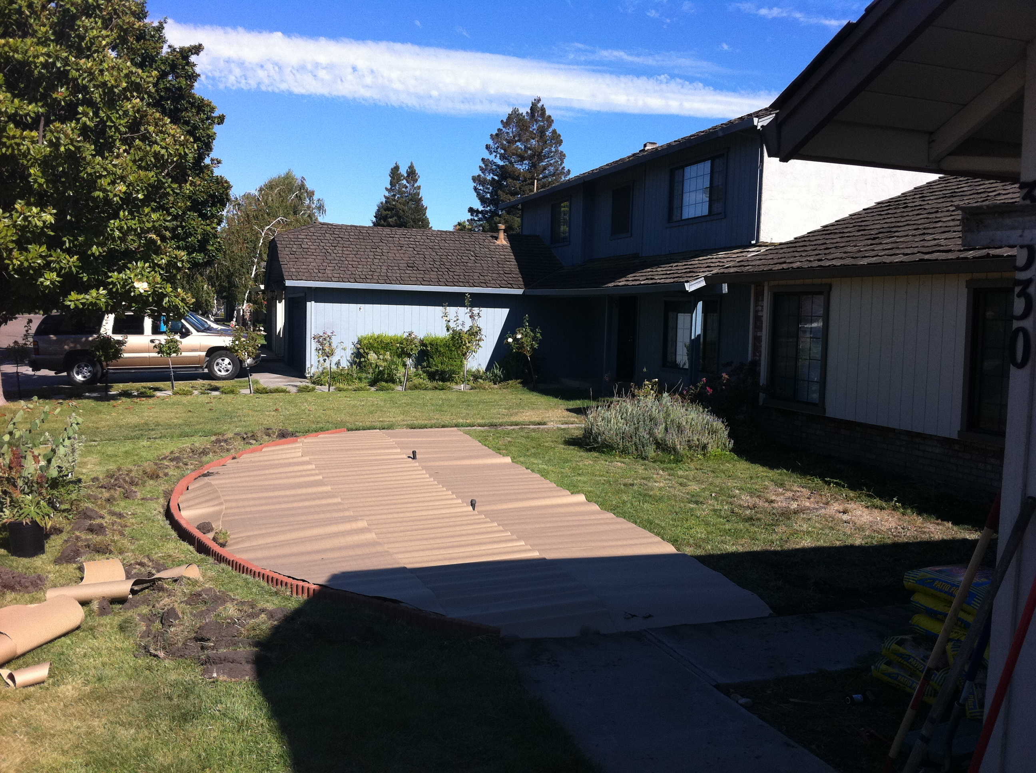
Native Front Yard Hedgerow

Slide 19
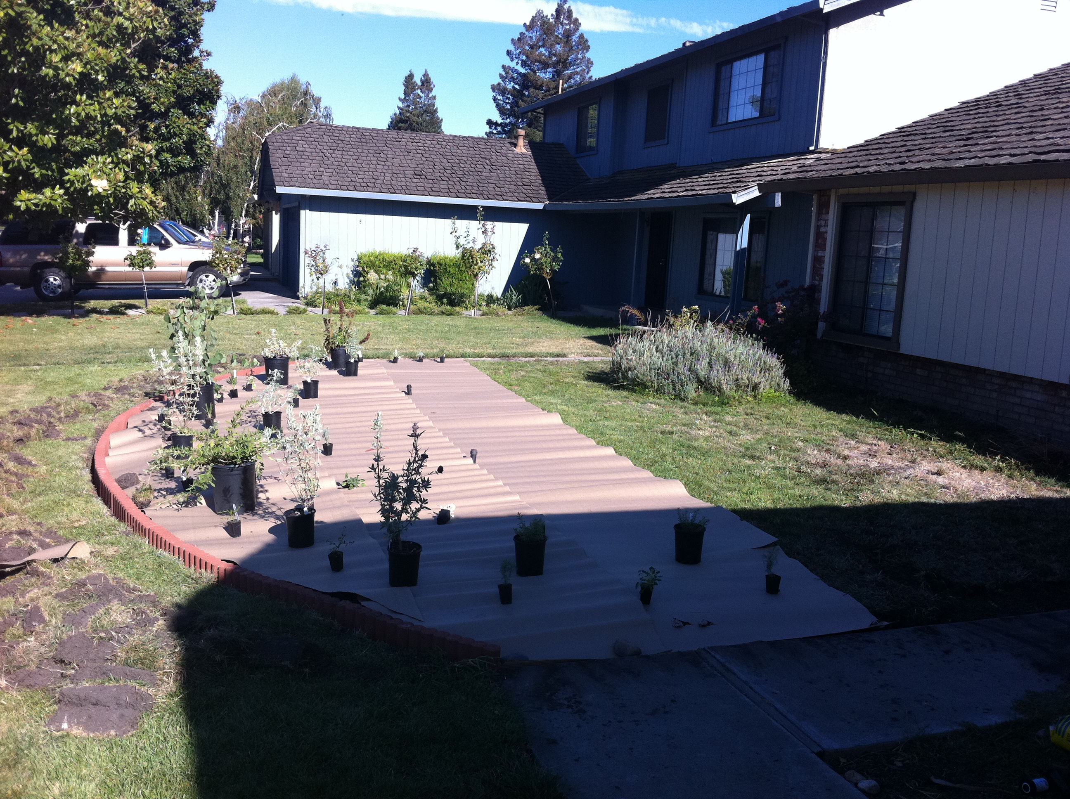
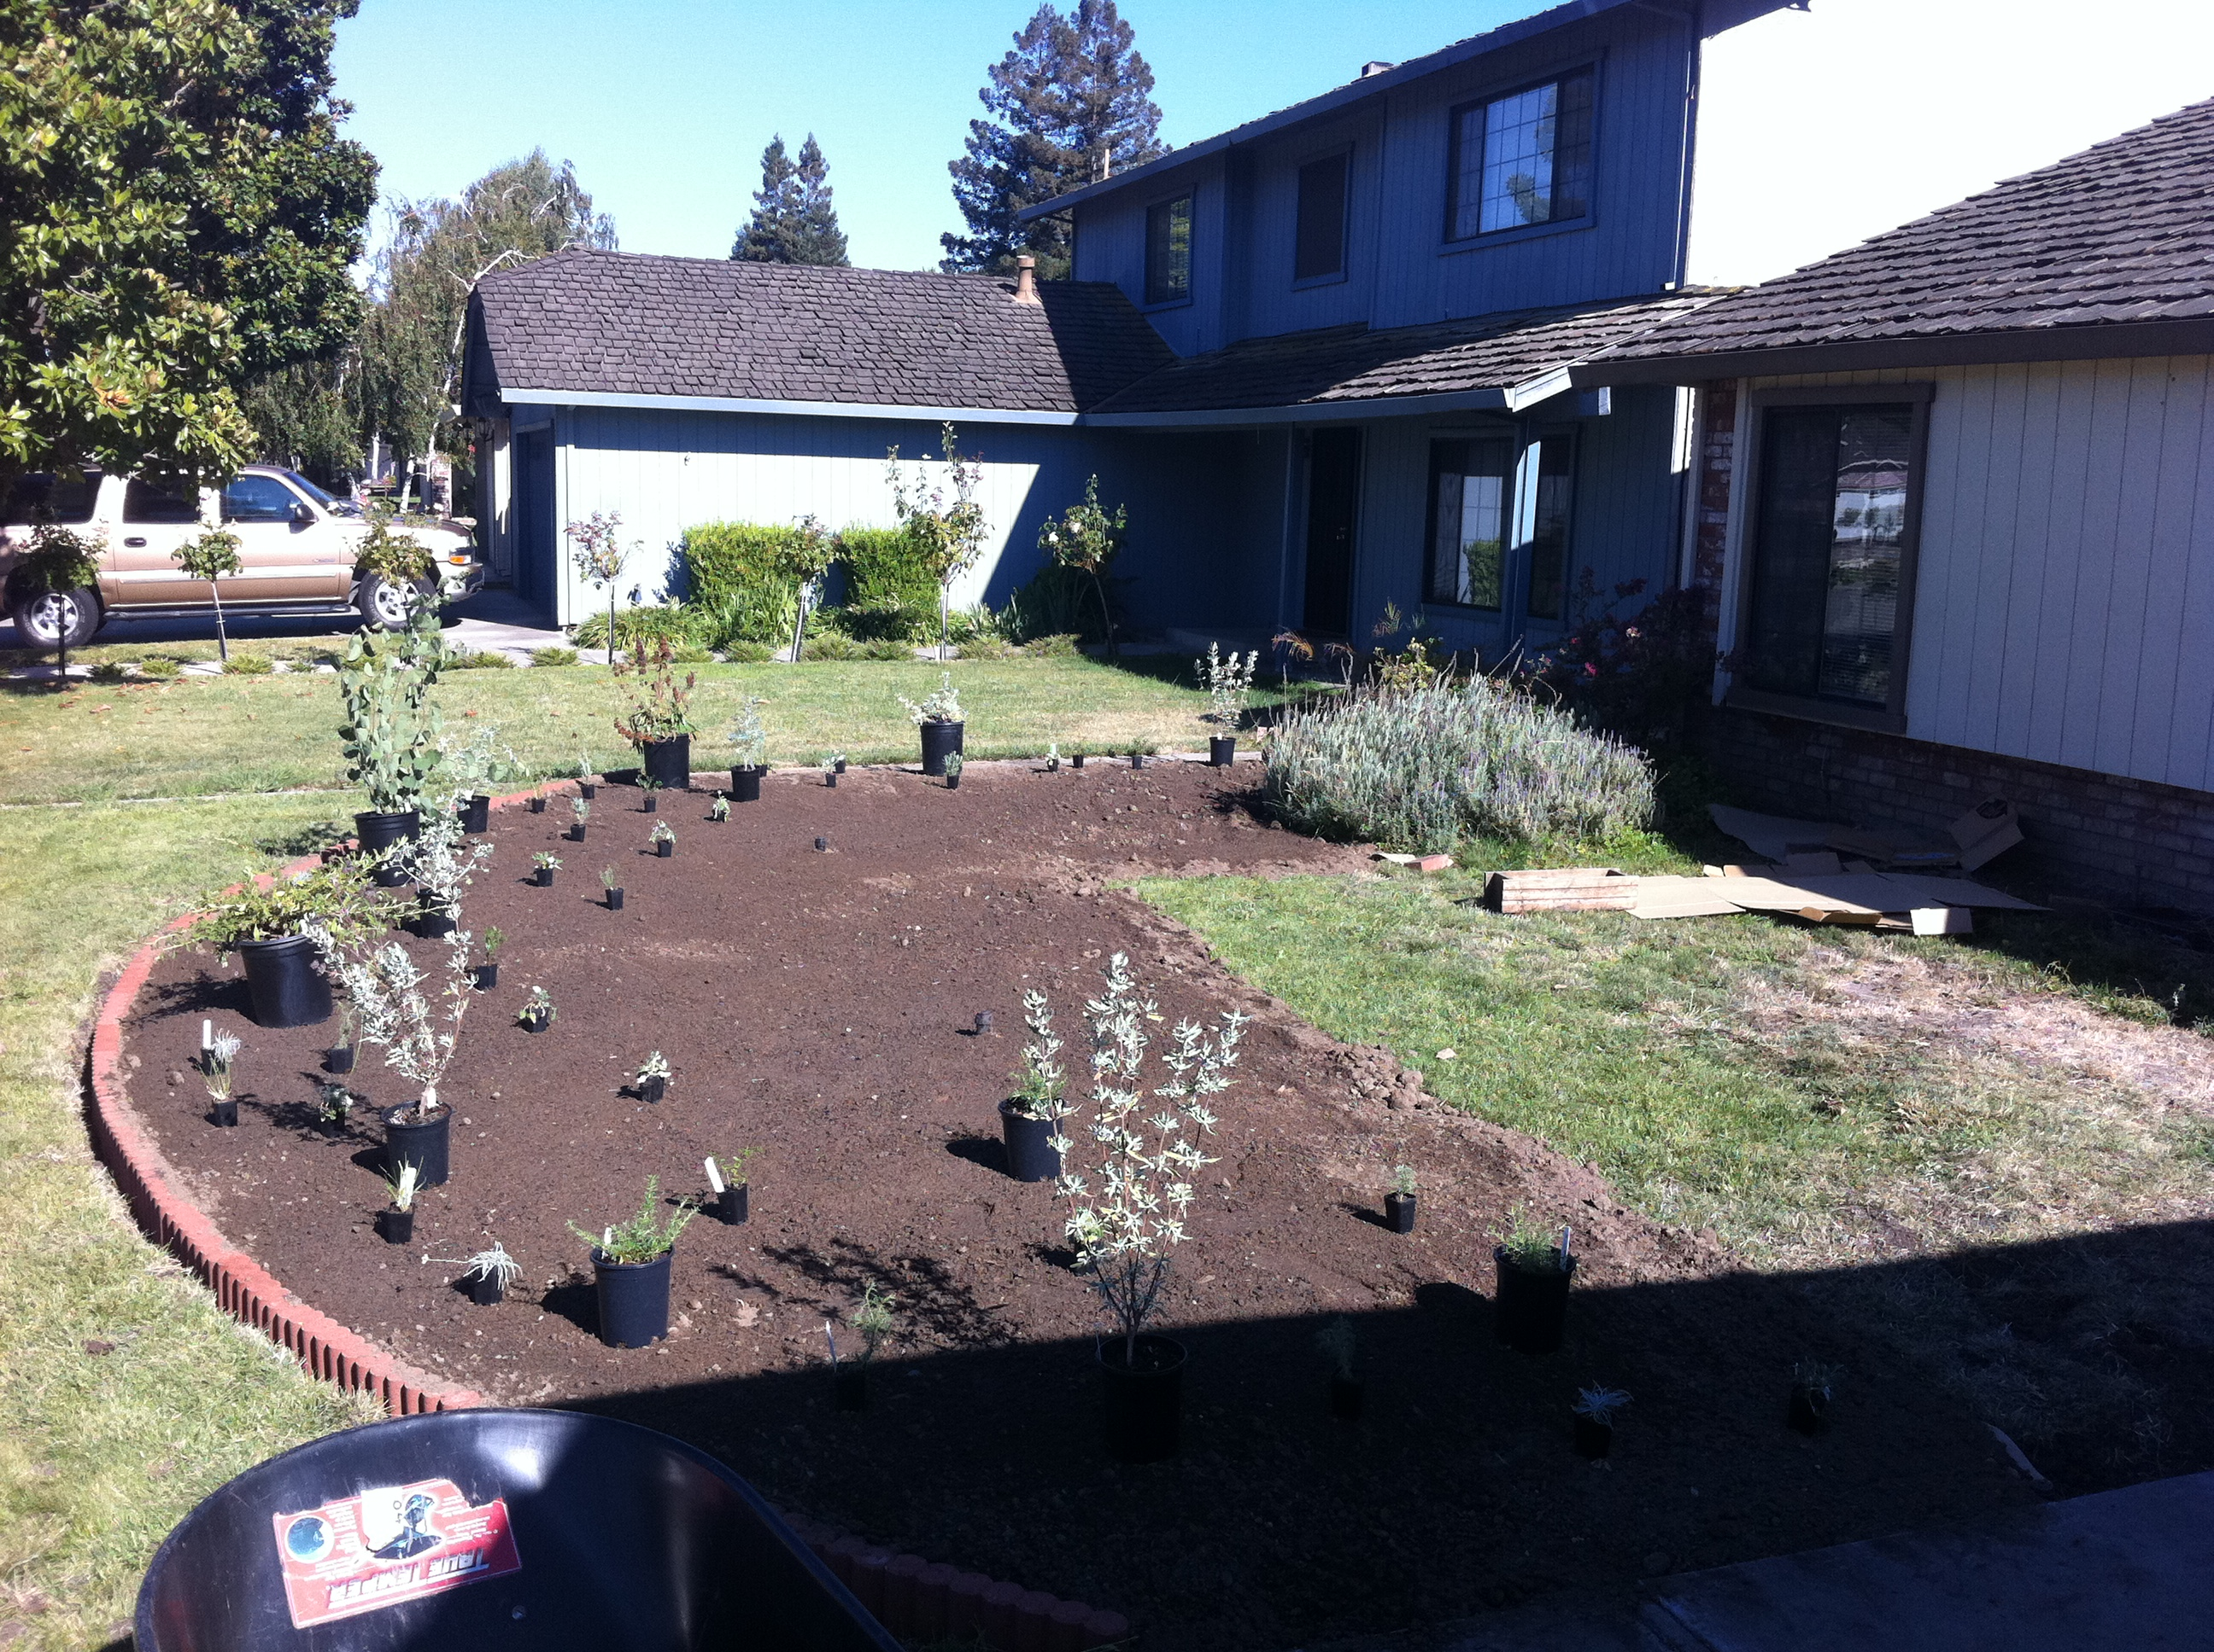
Native Front Yard Hedgerow

Slide 20
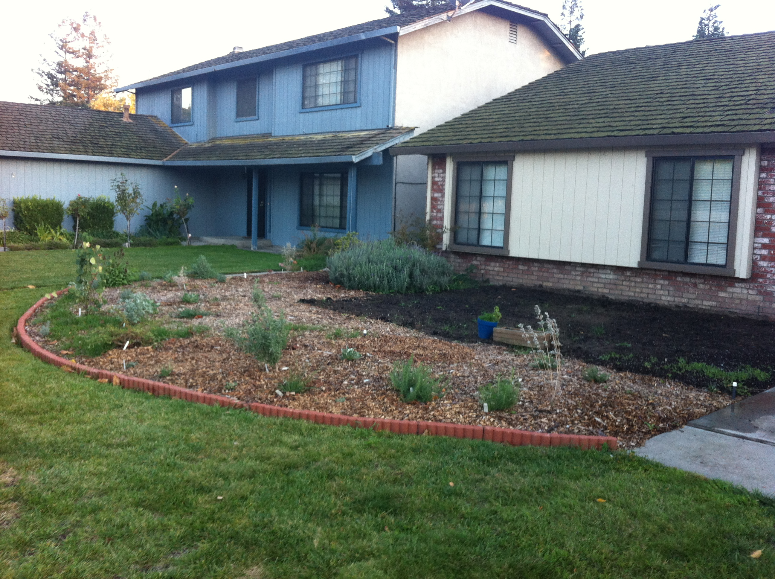
Native Front Yard Hedgerow

Slide 21
Native Front Yard Hedgerow

Slide 22
Thanks for Listening!

